Slide 1
Diabetes and Glucagon
Dave Bridges
dbridge9@uthsc.edu
Notes:
Talk about what the burnt orange slide means
To setup

Slide 2
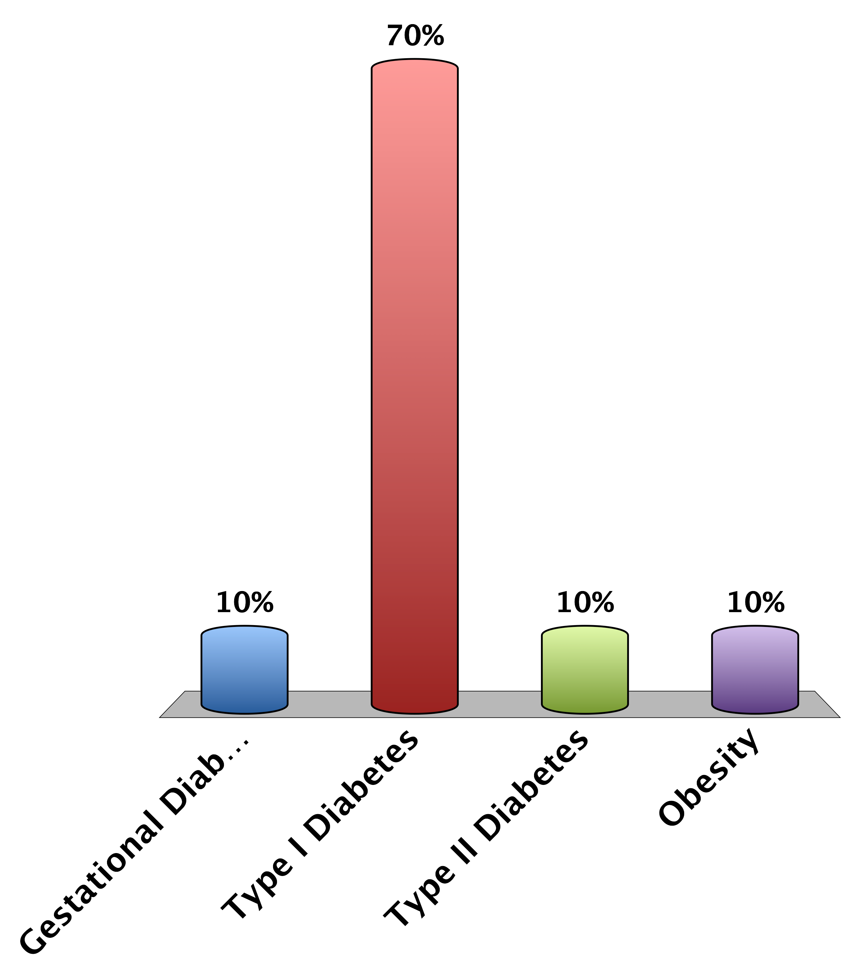
A lack of insulin production causes
Gestational Diabetes
Type I Diabetes
Type II Diabetes
Obesity
0

Slide 3
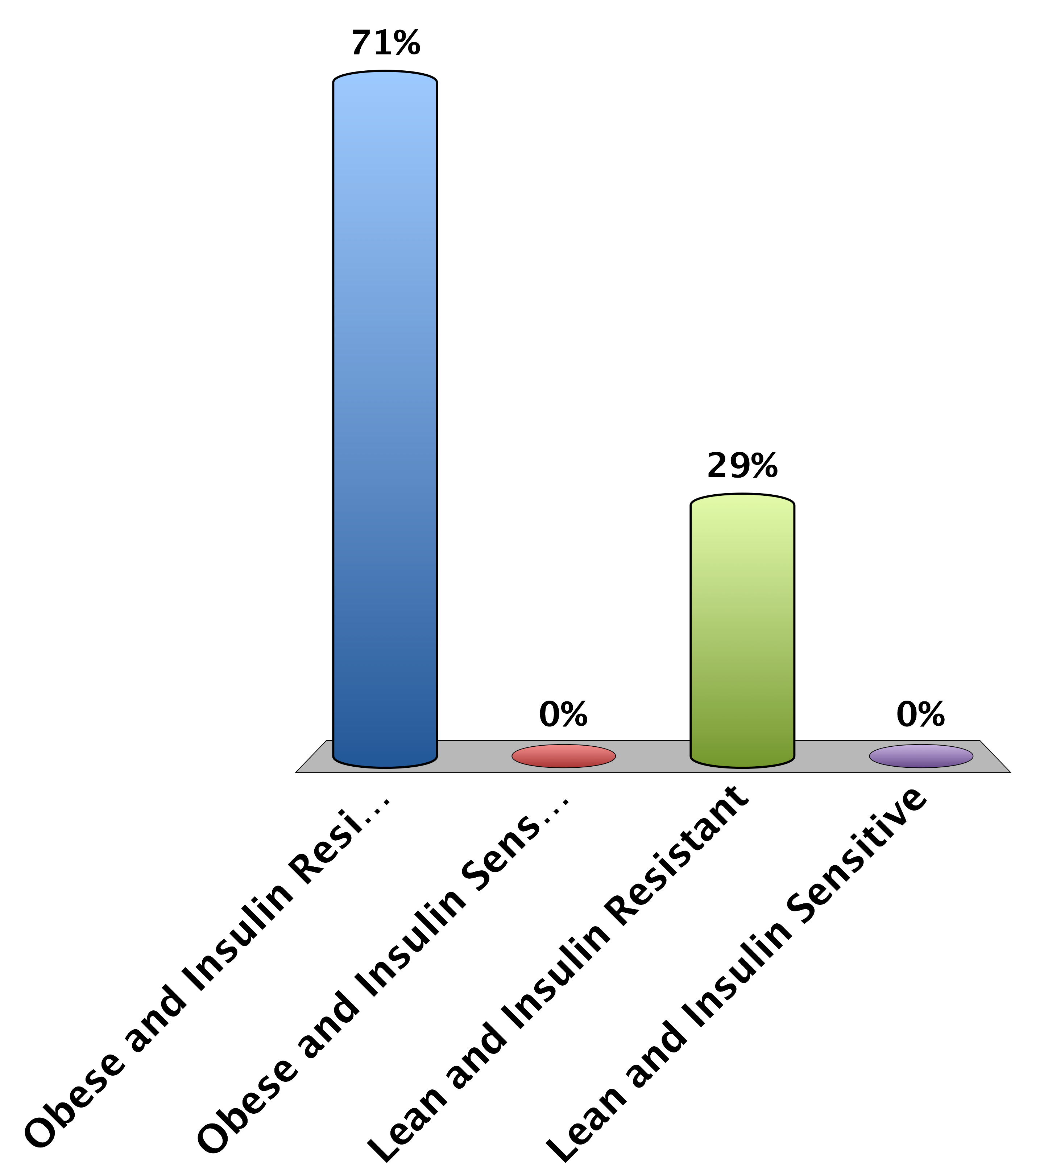
Type II Diabetics Tend To Be…
Obese and Insulin Resistant
Obese and Insulin Sensitive
Lean and Insulin Resistant
Lean and Insulin Sensitive
0

Slide 4
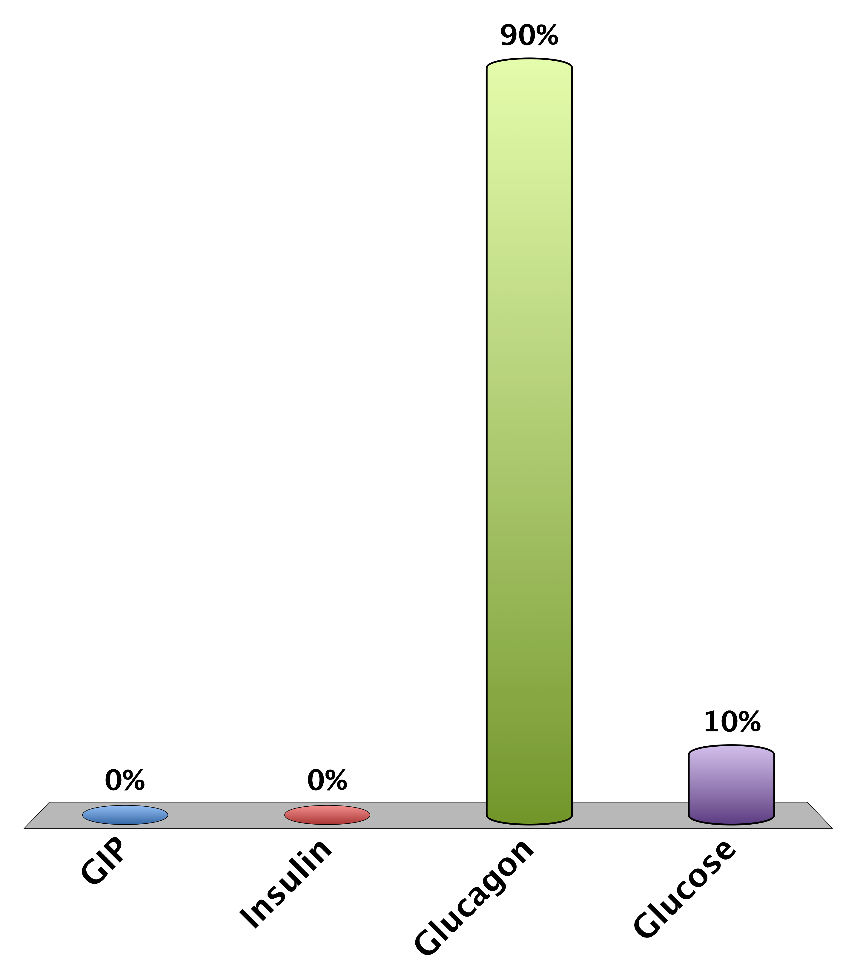
During Fasting Which Is Elevated
GIP
Insulin
Glucagon
Glucose
0

Slide 5
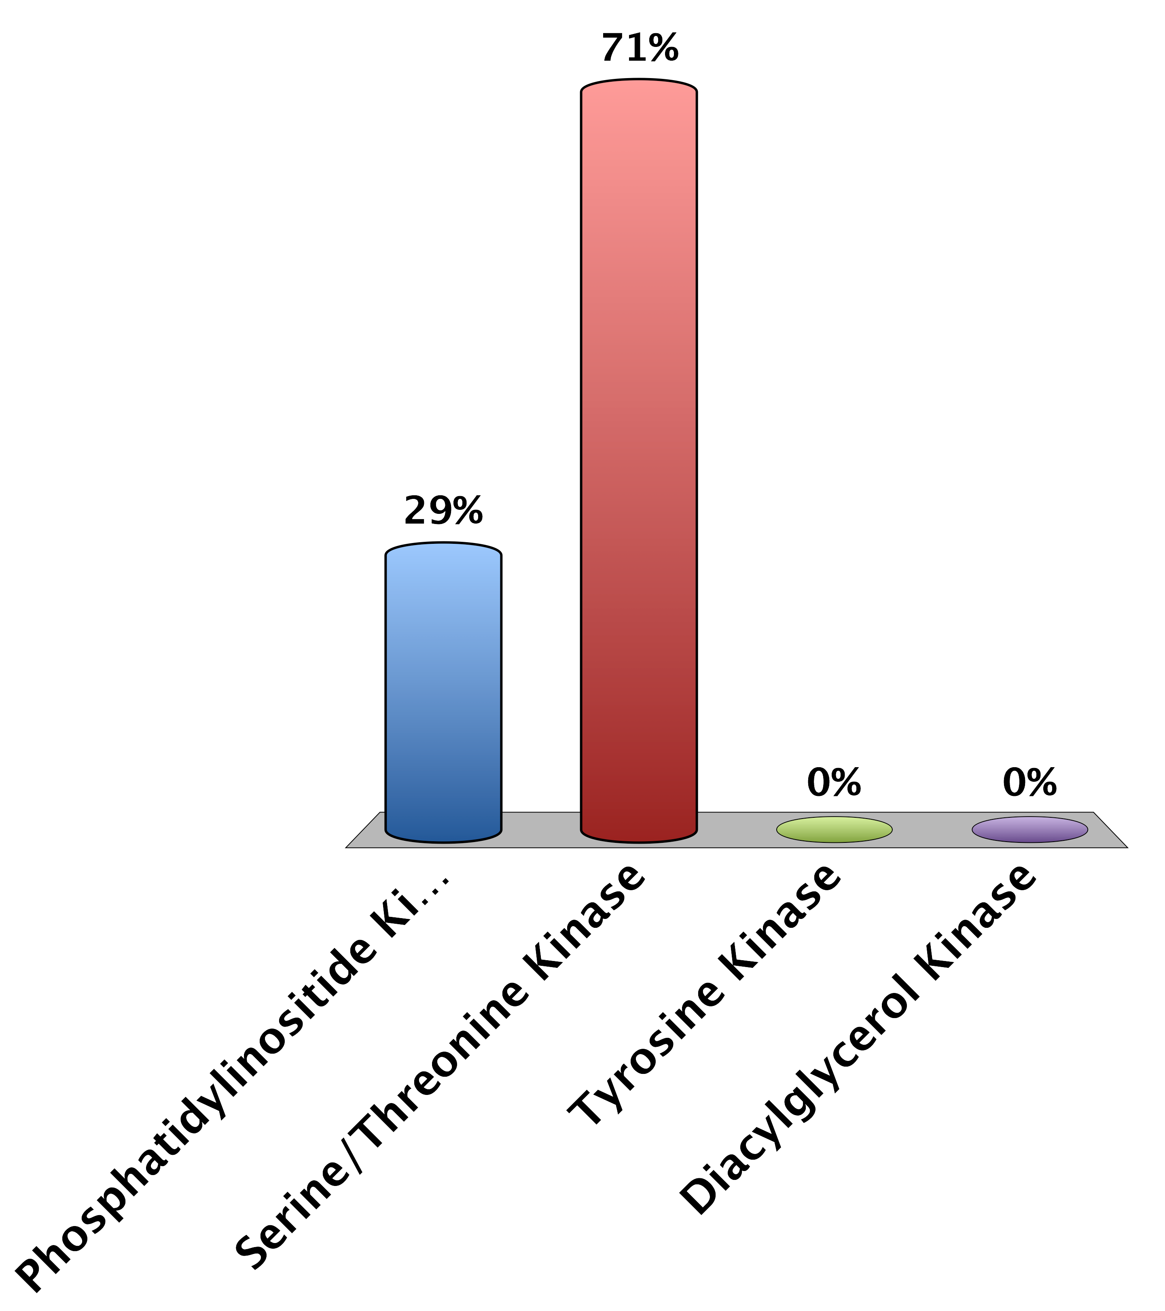
The Insulin Receptor is a…
Phosphatidylinositide Kinase
Serine/Threonine Kinase
Tyrosine Kinase
Diacylglycerol Kinase
0

Slide 6
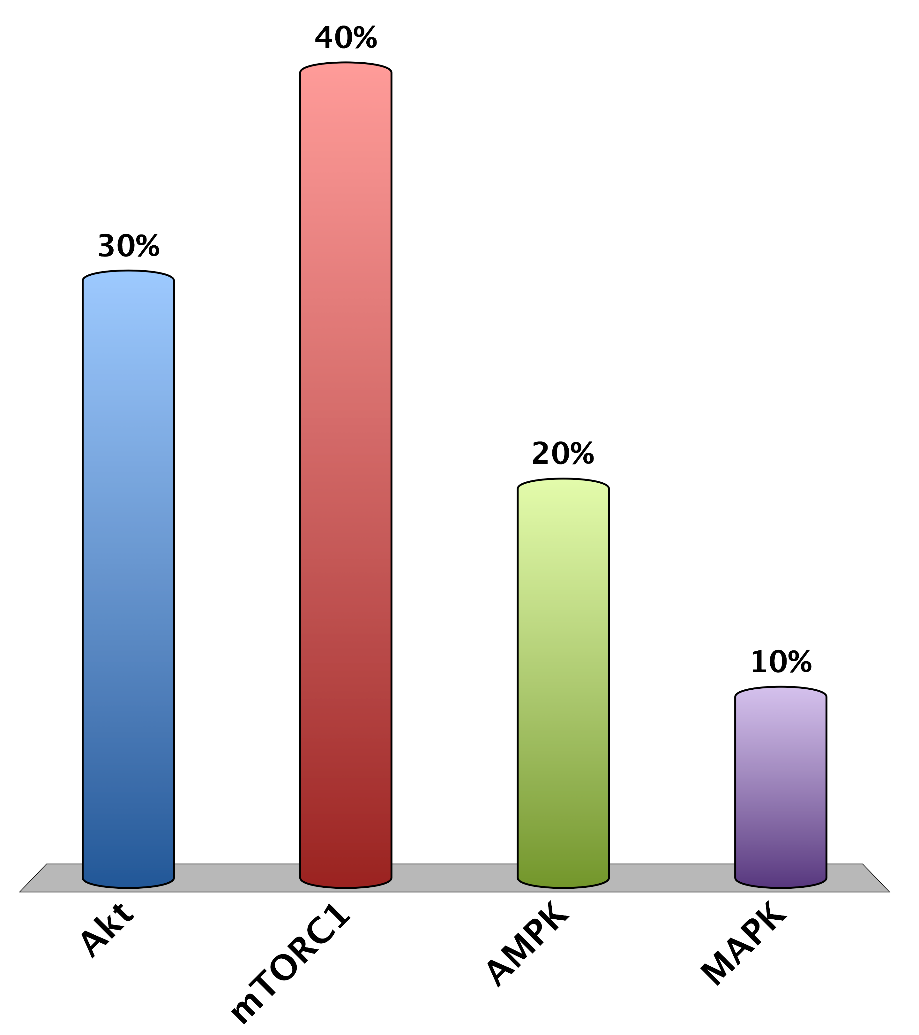
Which of the following are NOT activated by insulin signaling
Akt
mTORC1
AMPK
MAPK
0

Slide 7
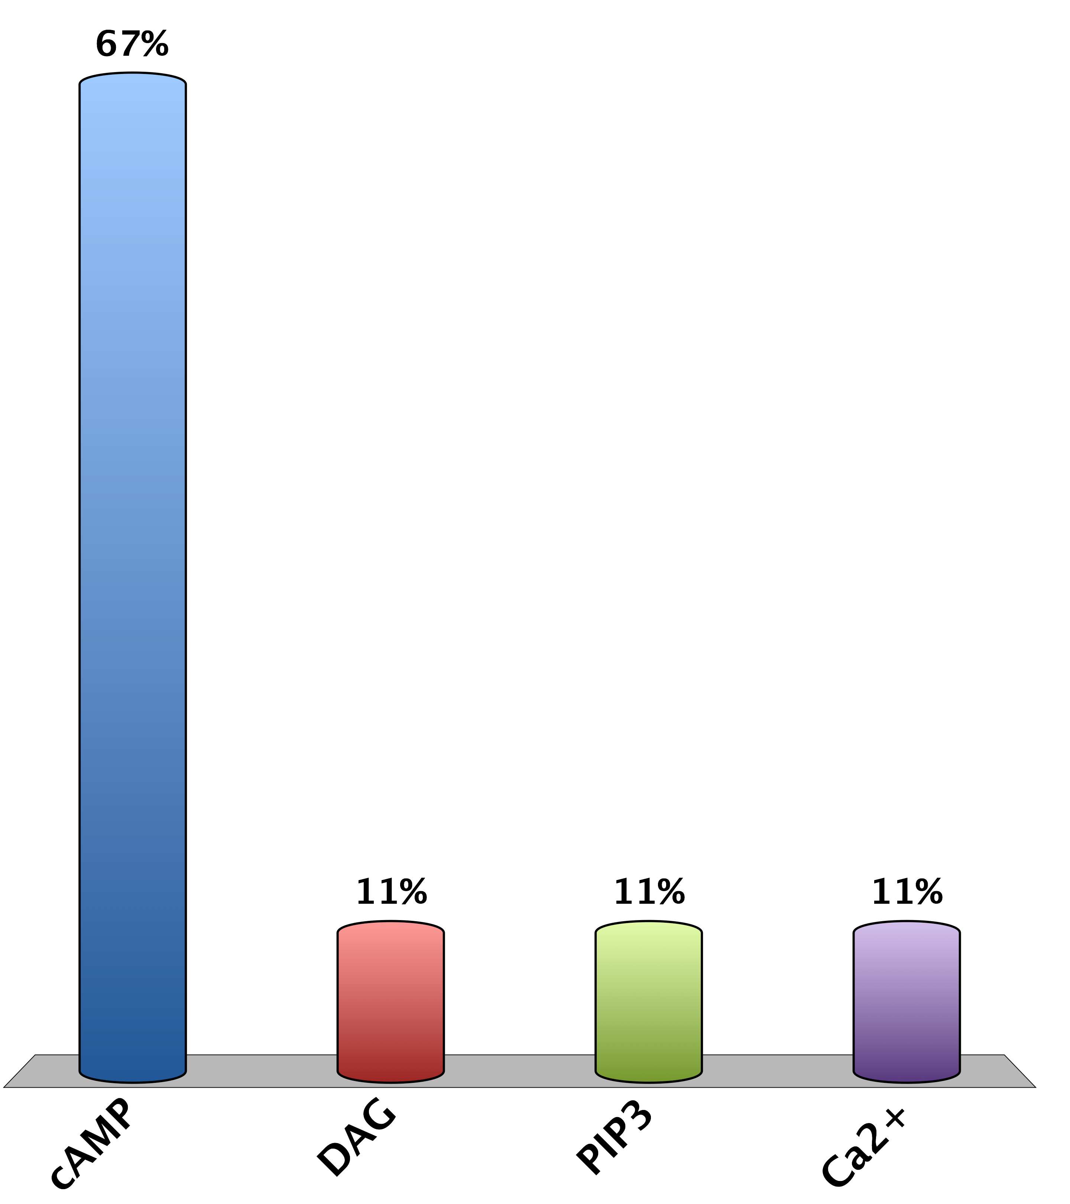
Which is the main second messenger in glucagon signaling
cAMP
DAG
PIP₃
Ca²⁺
0

Slide 8
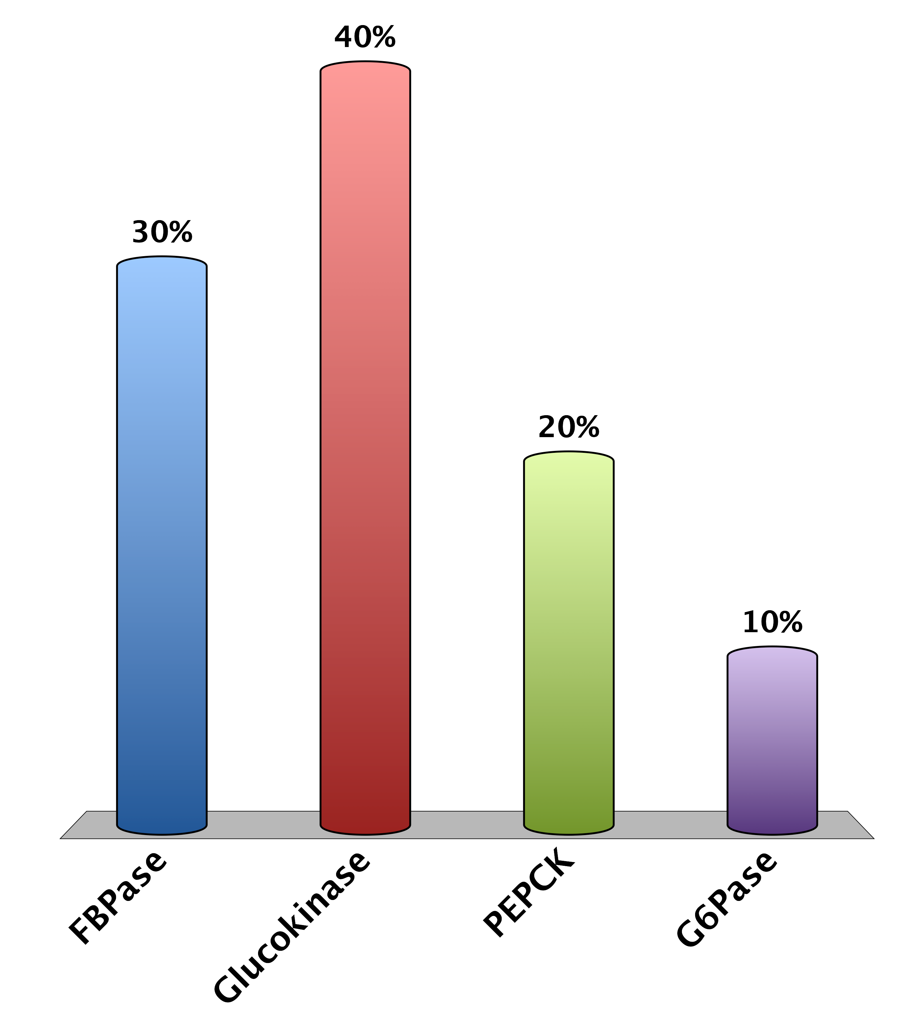
Which is NOT a key gluconeogenic enzyme
FBPase
Glucokinase
PEPCK
G6Pase
0

Slide 9
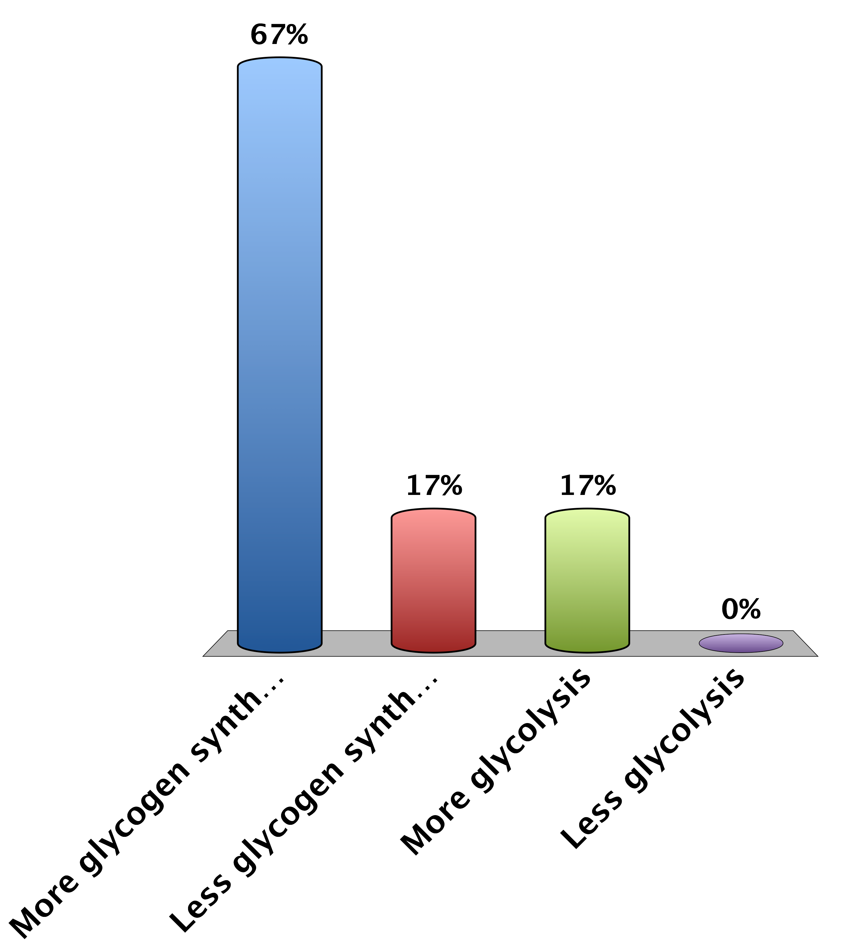
What is the effect of dephosphorylating glycogen synthase and glycogen phosphorylase?
More glycogen synthesis
Less glycogen synthesis
More glycolysis
Less glycolysis
0

Slide 10
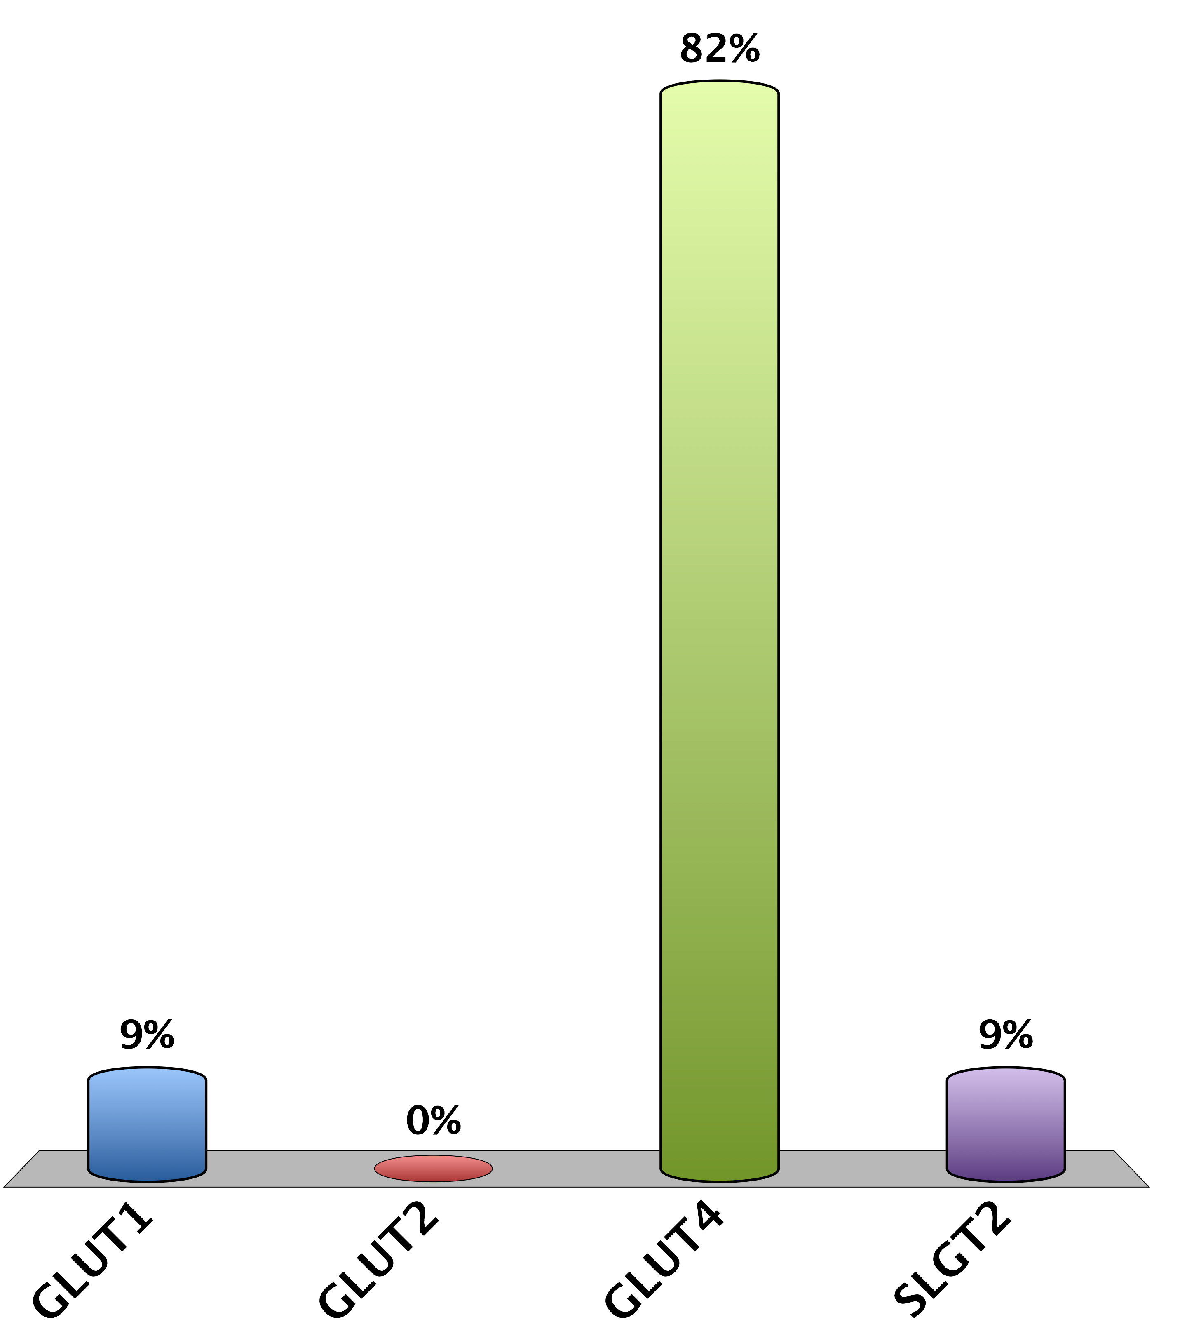
What is the main insulin responsive glucose transporter
GLUT1
GLUT2
GLUT4
SLGT2
0

Slide 11
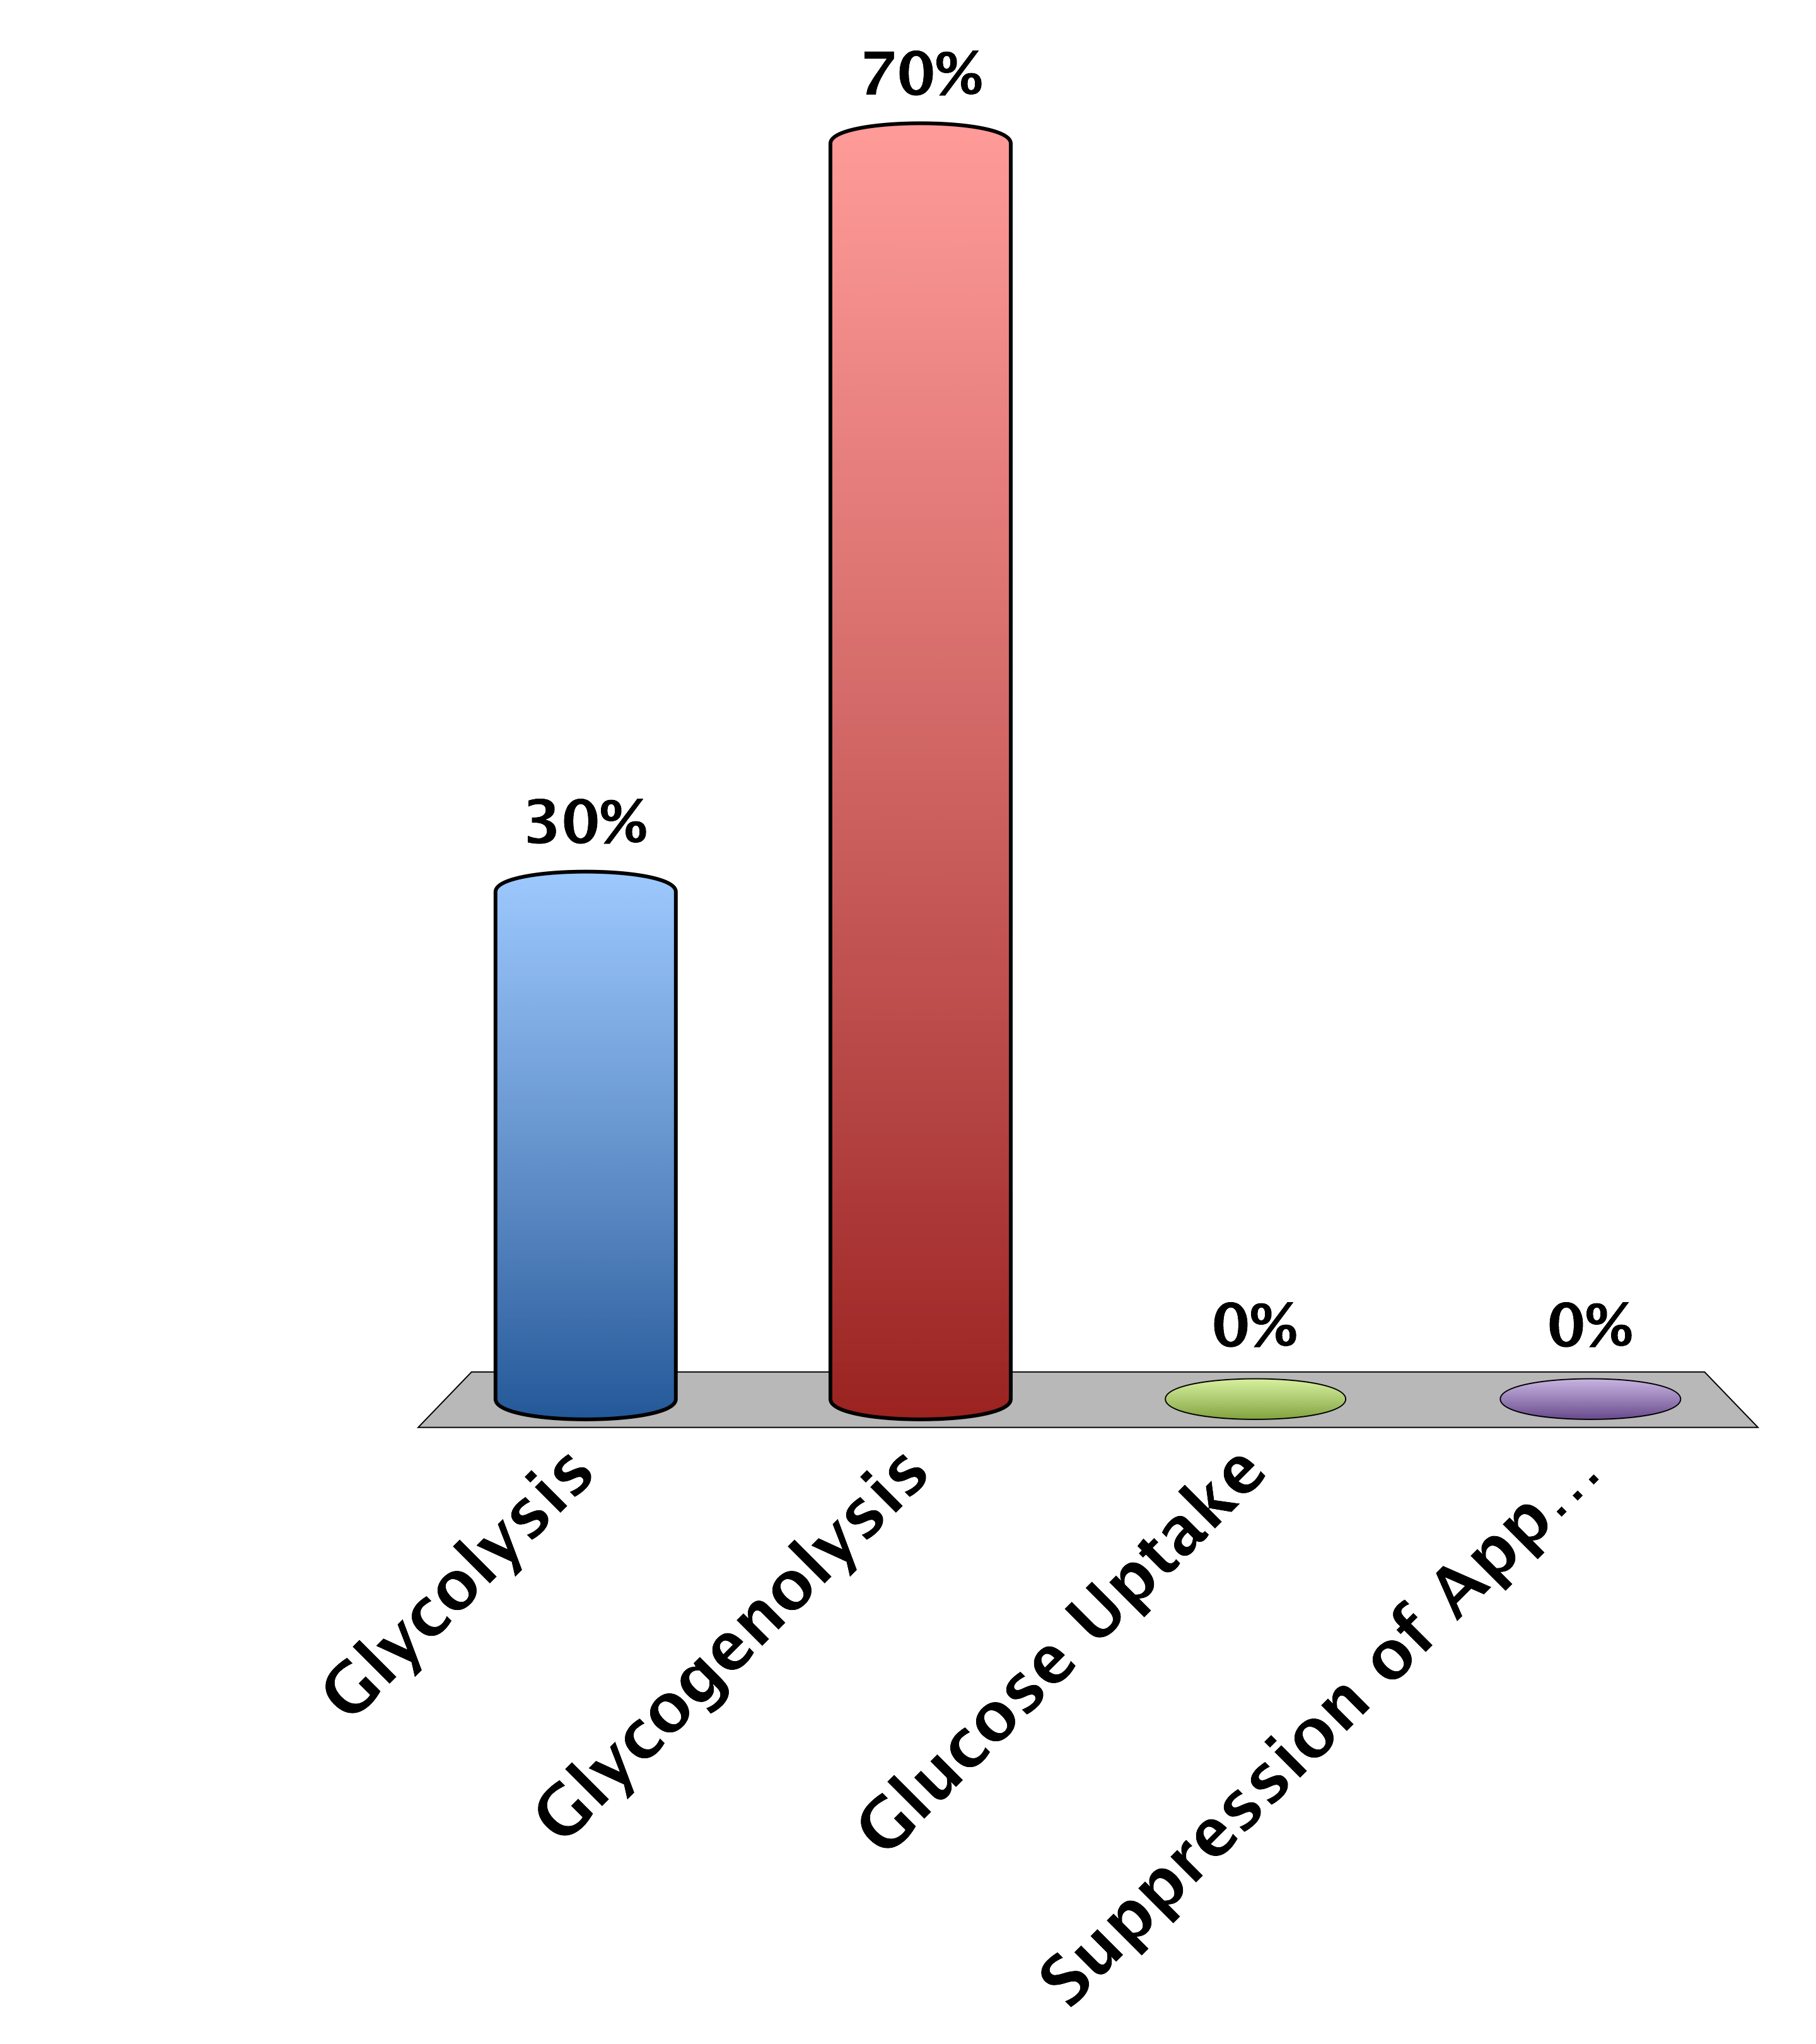
Which of the following will increase plasma glucose
Glycolysis
Glycogenolysis
Glucose Uptake
Suppression of Appetite
0

Slide 12
Diabetes Mellitus
One of the first described diseases (1500 BC)
Named diabetes by Appolonius of Memphis (Egypt)
Diabetes (to pass through)
Mellitus (from honey)

Slide 13
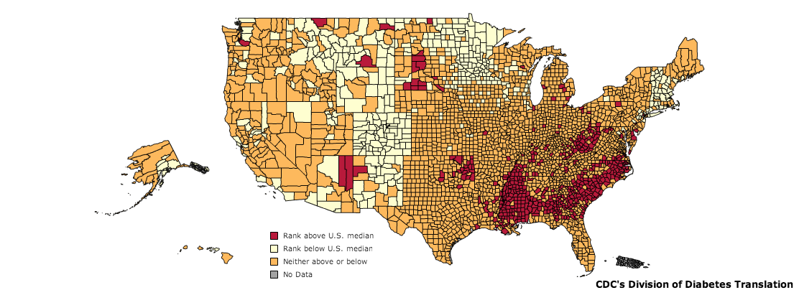
Diabetes in the United States
CDC, 2010
Notes:
As of 2011, diabetes affects 25.8 million people or 8.3% of the population. This includes approximately 7 million undiagnosed individuals. In addition to this, 79 million Americans over the age of 20 are estimated to be pre-diabetic. As of 2007, diabetes is estimated to cost $116 billion in direct and $58 billion in indirect costs [@CDC2011].
Diabetes is especially prevalent in this region. As shown in the map, there is a higher percentage of diabetics in the mid and deep south regions of the United States.

Slide 14
Complications of Diabetes
Retinopathy
Leading cause of blindness in 20-75 year olds
Nephropathy
30% to 40% of all diabetics are symptomatic
Neuropathy
risk of amputation >25 times greater than that of people without diabetes.
Cardiovascular
Heart Attack/Stroke Risk 2-4X with diabetes

Slide 15
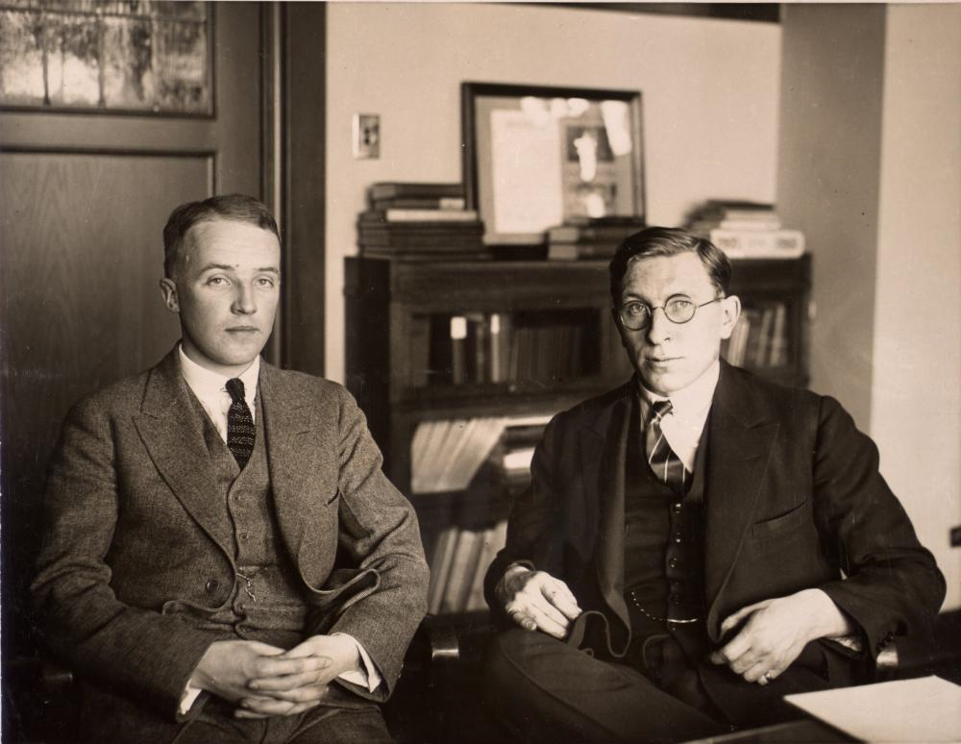
The Discovery of Insulin
Notes:
1889 von Mering and Minkowski (Pancreatectomy mimics disease)
Banting was a surgeon adept at pancreatectomizing dogs, Best was a lab technician who was very good at measuring blood glucose. MacLeod provided them lab space at the University of Toronto

Slide 16
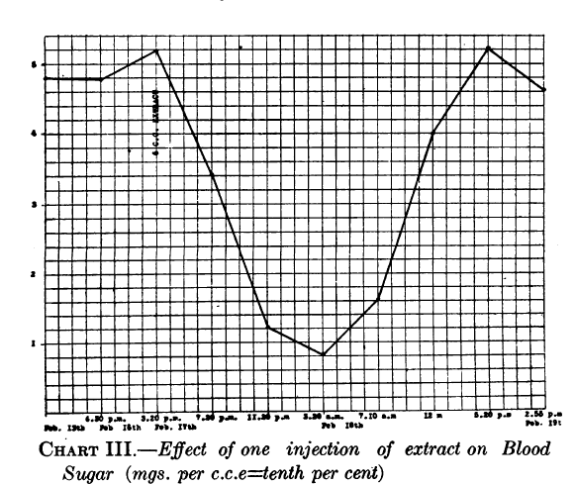
The Discovery of Insulin
Banting et al. 1922
Notes:
Insulin was discovered by Frederick Banting and his colleagues at the University of Toronto in 1921. They performed experiments in which they injected extracts
from pancreas fractions into dogs which had their pancreas’ surgically removed. They showed that a secreted substance from the pancreas lowered blood glucose
in these dogs (Frederick G. Banting and Best 1922). This is an image of dog pancreas isolate injected into a diabetic child

Slide 17
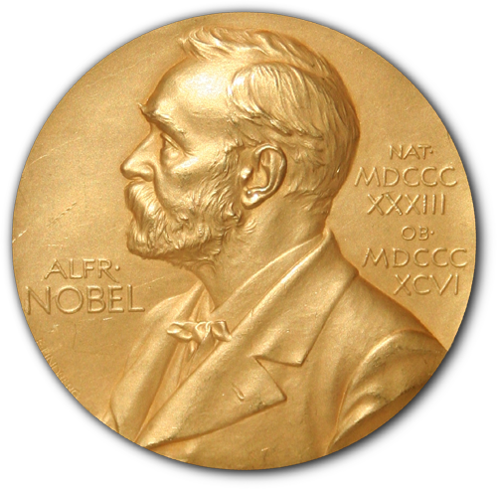
Nobel Prizes in Glucose Homeostasis
Banting and MacLeod (1923 – Discovery of Insulin)
Carl and Gerty Cori (1947 – Glycogen Regulation)
Krebs and Lipman (1953 – Glycolysis and Krebs Cycle)
Sanger (1958 – Sequencing Insulin Peptide)
Bloch and Lynen (1964 – Fatty Acid Metabolism)
Earl Sutherland (1971 – Second Messengers)
Brown and Goldstein (1985 – Cholesterol Metabolism)
Fisher and Krebs (1992 – Protein Phosphorylation)
Gilman and Rodbel (1994 – GPCR Signaling)
Rothman, Sheckman and Sudhof (2013 – Secretory Pathways)
Source: www.nobelprize.org

Slide 18
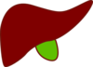

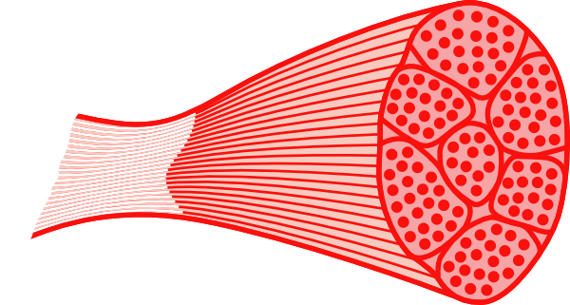
Regulation of Blood Glucose Levels
Gluconeogenesis
Disposal
Glucose Uptake
Glucose Storage
Glucose Utilization
Glucose Production
Glucose Uptake
Glucose Storage
and Utilization
Notes:
Ask for some examples of how glucose is stored, or how it is utilized

Slide 19
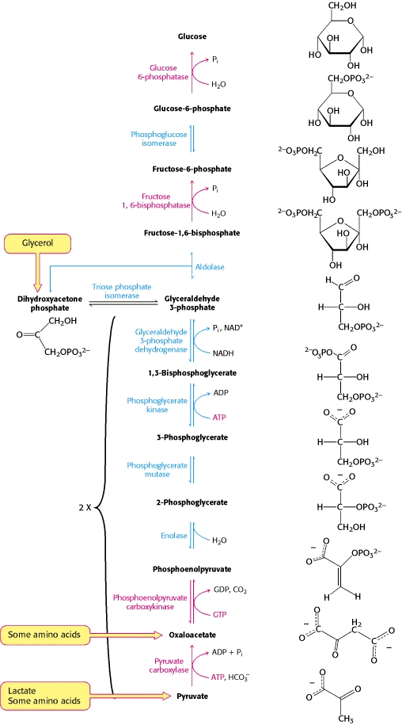
Gluconeogenesis
Uses amino acids and fatty acids to generate glucose
Key enzymes are PEPCK, FBPase and G6Pase
Notes:
Where does this mainly occur

Slide 20
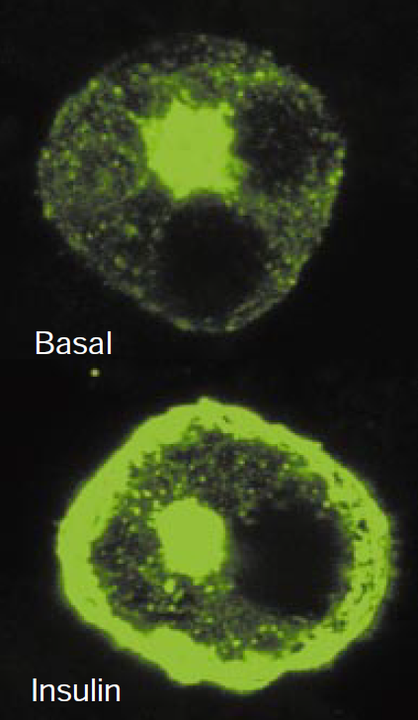
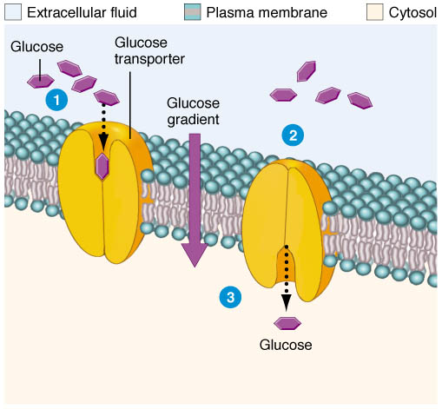
Glucose Uptake
Passive Glucose Uptake
Stimulated Glucose Uptake
Brain
Liver
Kidneys
Fat
Muscle
GLUT4-eGFP
From Saltiel and Kahn (2001) Nature 414:799-806
From http://classroom.sdmesa.edu/eschmid/Chapter3-Zoo145.htm

Slide 21
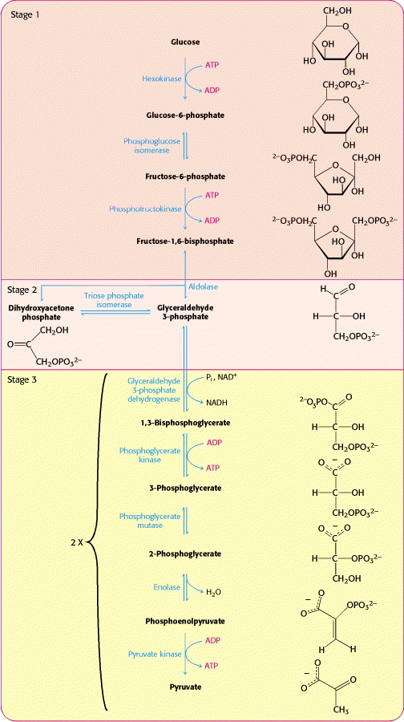
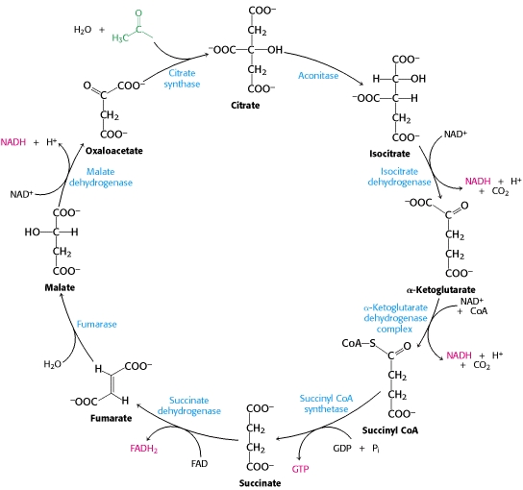
Glycolysis and Oxidative Phosphorylation
From Berg, Tzymozcko and Stryer Biochemistry (2002) http://www.ncbi.nlm.nih.gov/books/NBK22427
Notes:
These are the major glucose consuming pathways for energy generation

Slide 22
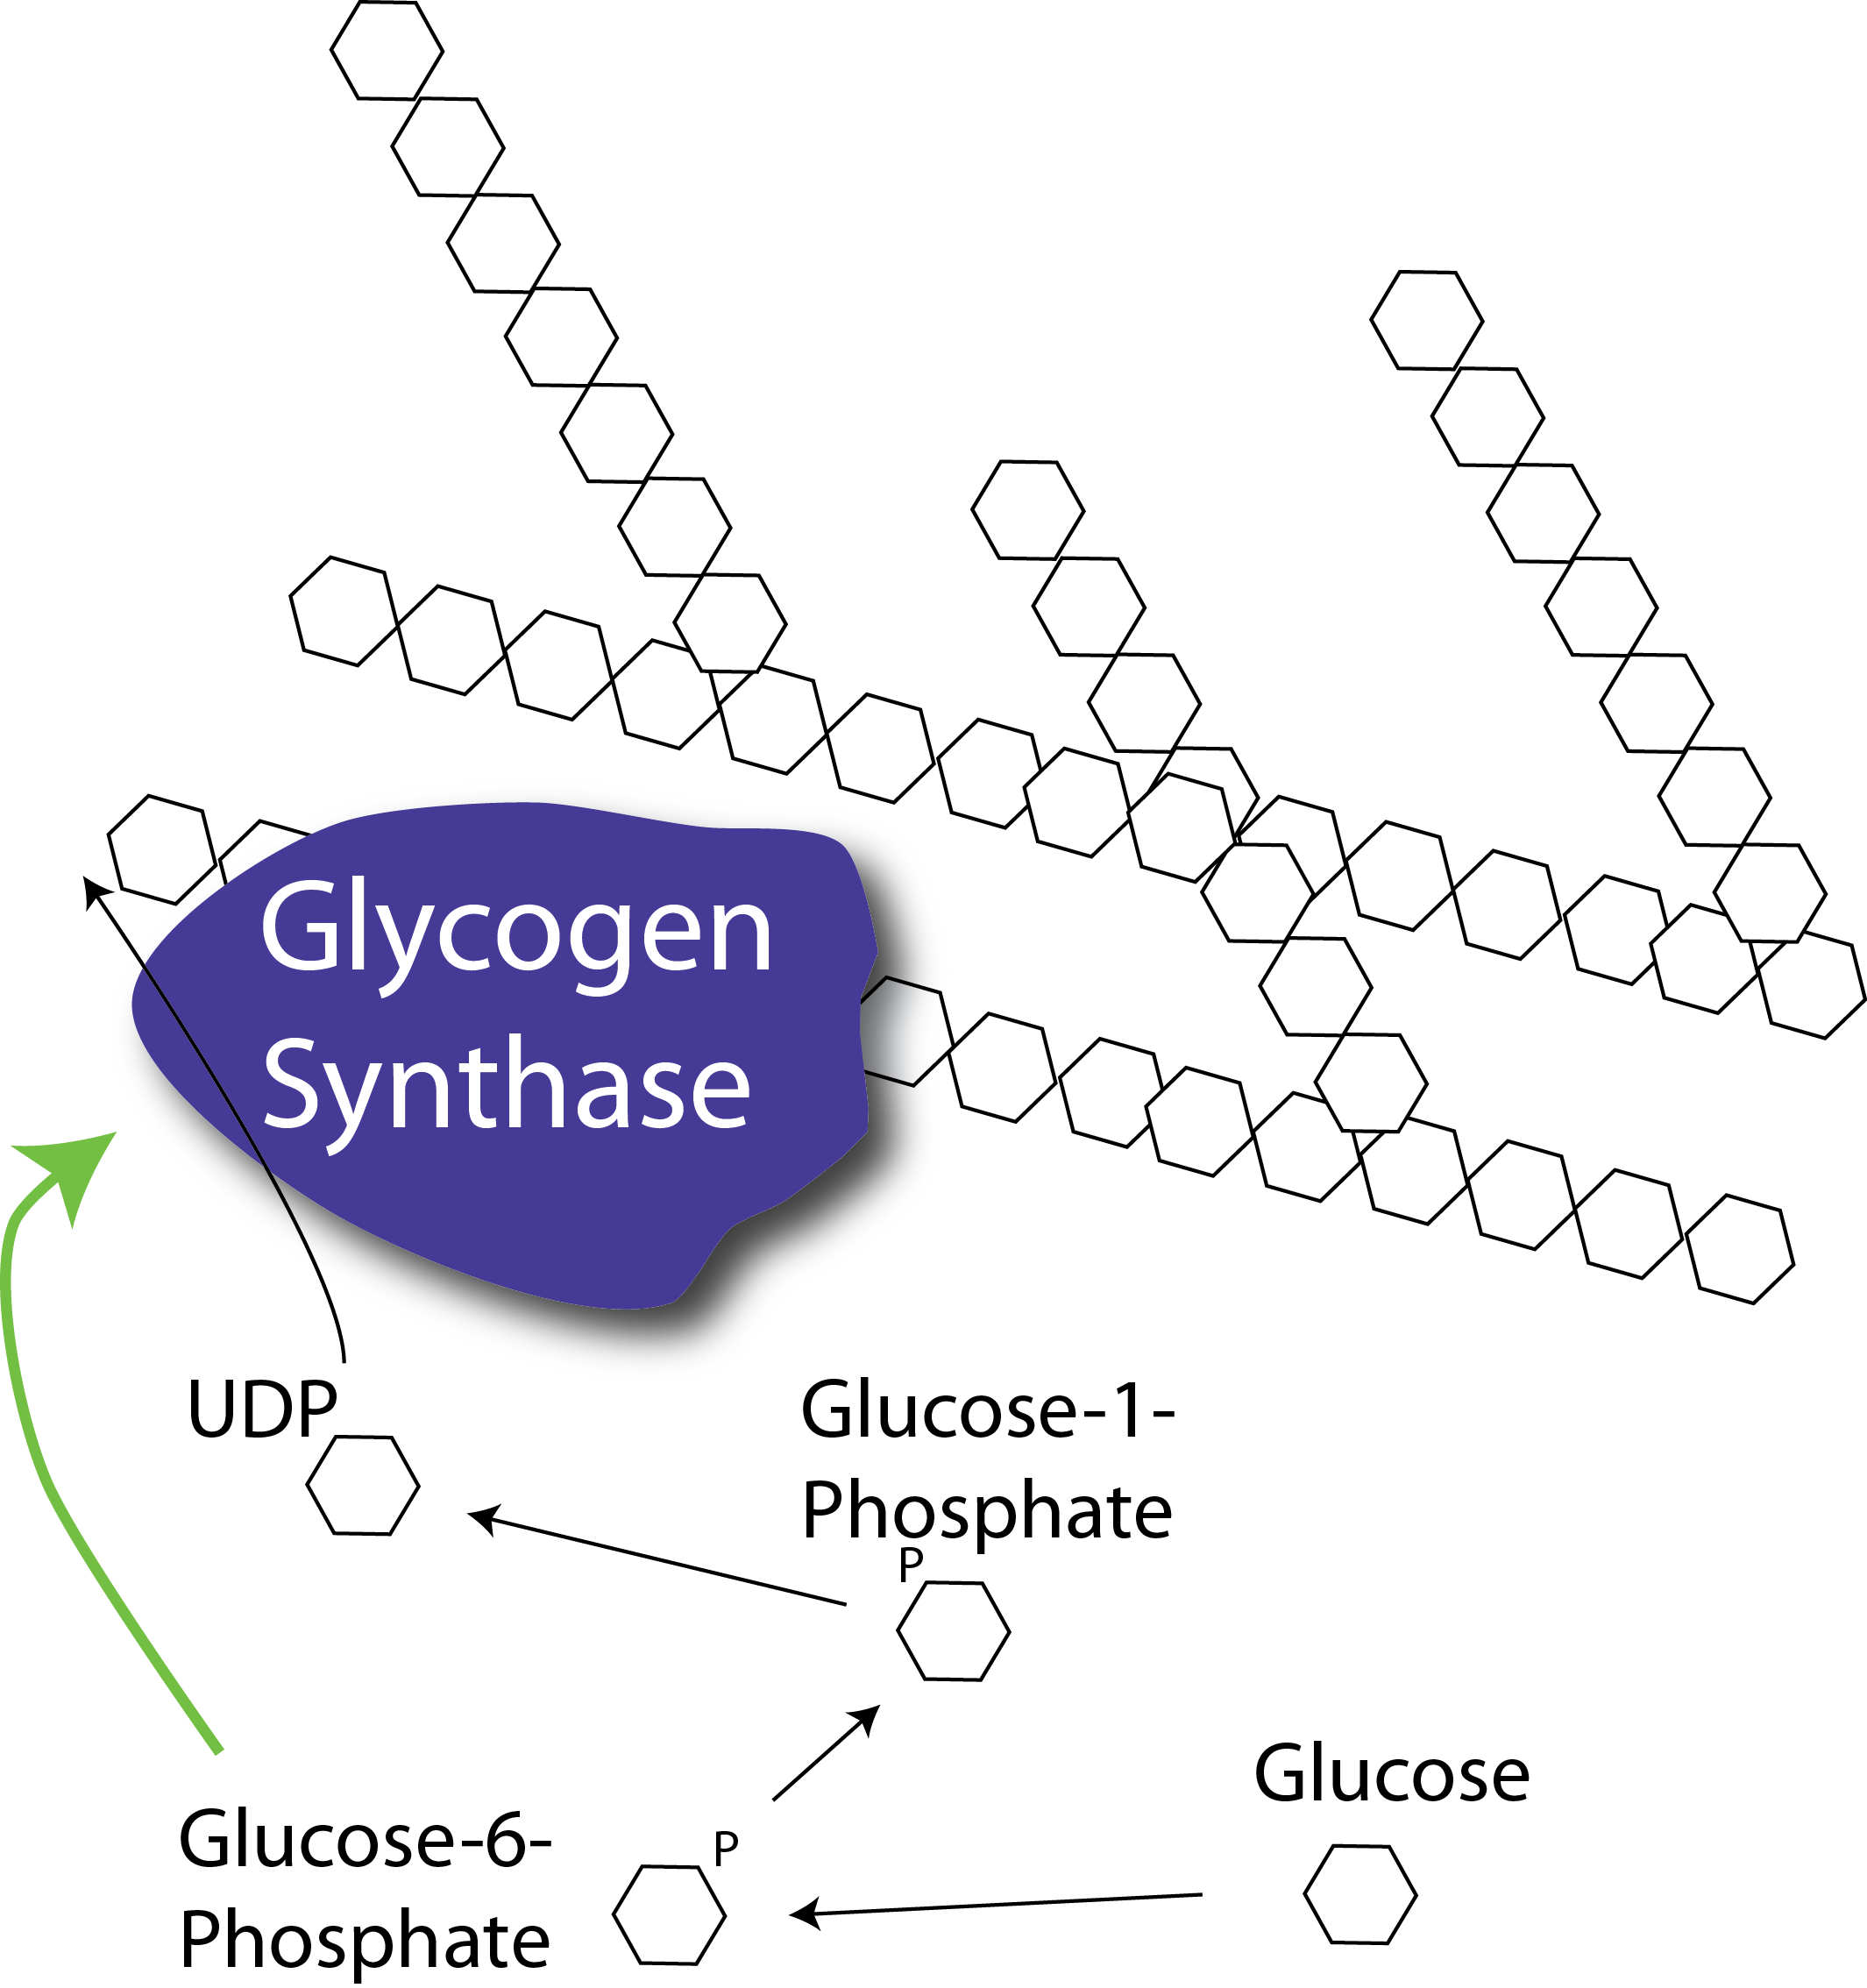
Glycogenesis
Notes:
Rate limiting step is the regulation of glycogen synthase activity.
Allosterically activated by Glucose-6-Phosphate, which is increased during glucose uptake and glycolytic flux

Slide 23
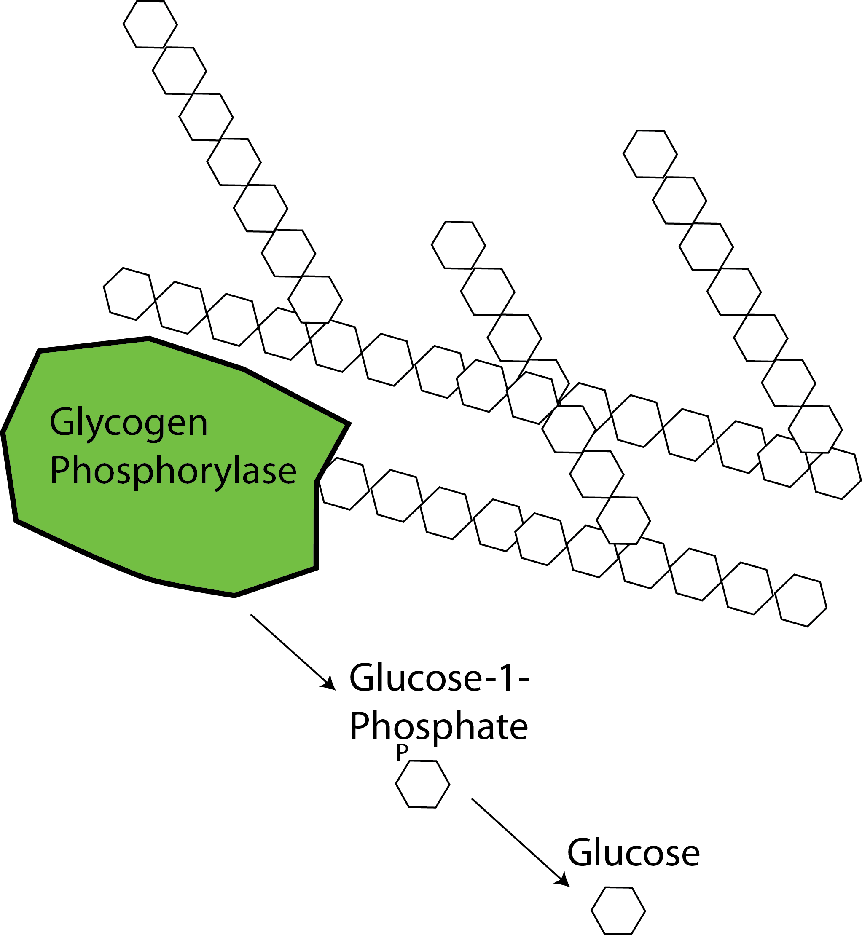
Glycogenolysis

Slide 24
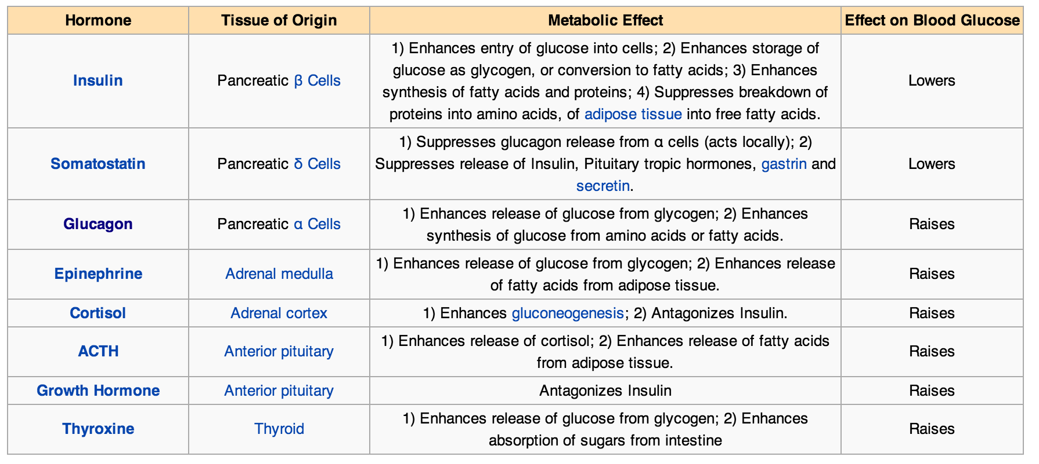
Endocrine Control of Blood Glucose
Blood Glucose in Wikipedia retrieved Oct 30, 2013 from
http://en.wikipedia.org/wiki/Blood_sugar_regulation

Slide 25
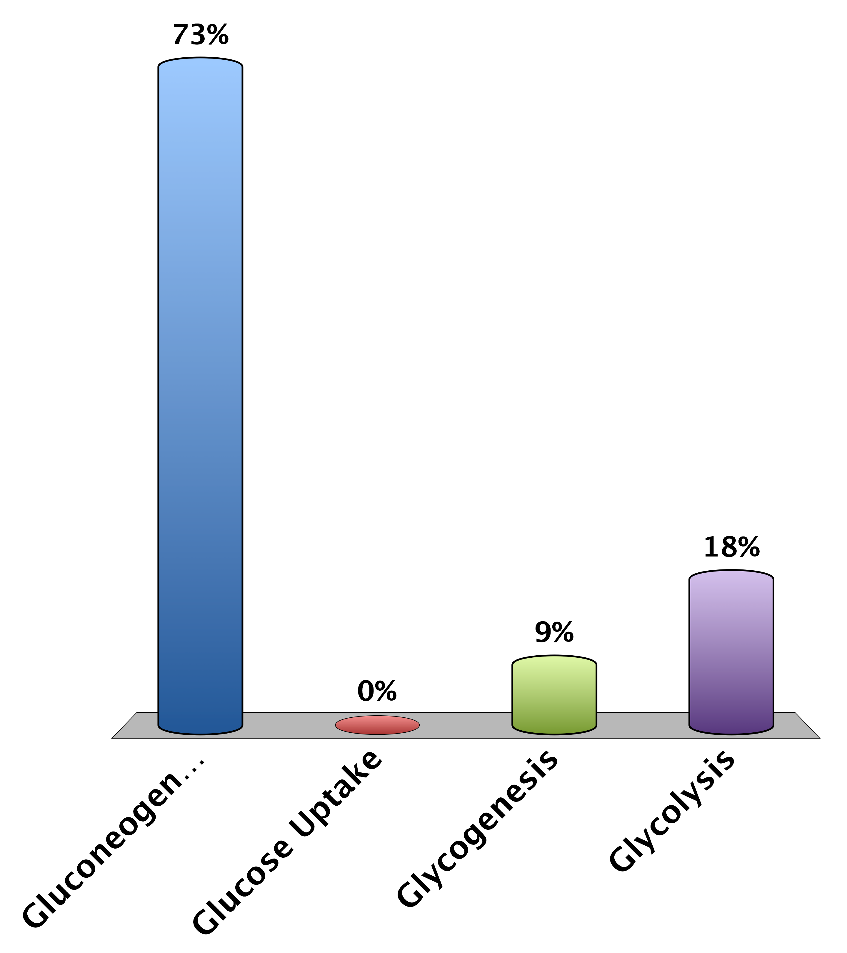
What does insulin NOT activate?
Gluconeogenesis
Glucose Uptake
Glycogenesis
Glycolysis
0

Slide 26
Mechanisms to Reduce Blood Glucose

Slide 27

Functions of Insulin
Promotes the uptake of glucose from the blood into muscle and adipose tissue.
Enhances the synthesis of glycogen and triglycerides in liver, adipose and muscle.
Insulin inhibits gluconeogenesis, or the production of glucose from non-glucose precursors such as amino acids and lipids.
Promote glucose breakdown and prevent lipid breakdown
Food
Circulating
Nutrients
(Glucose)
Glucose Production
Glucose Disposal
Insulin
Secretion
Nutrient Storage

Slide 28
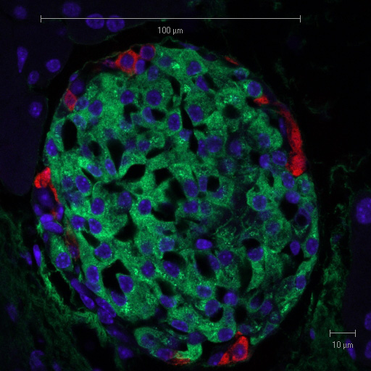
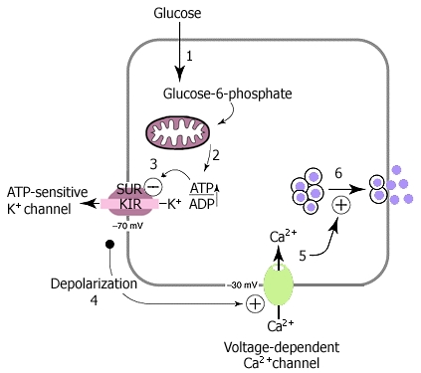
Insulin Secretion
Suckale and Solimena (2008) Frontiers in bioscience 13:7156-71
Pancreatic Islet with Glucagon and Insulin Staining
From Solilema Lab (http://en.wikipedia.org/wiki/Islets_of_Langerhans)
Notes:
Red is glucagon, green is insulin
What happens if you cannot secrete insulin from beta cells?

Slide 29
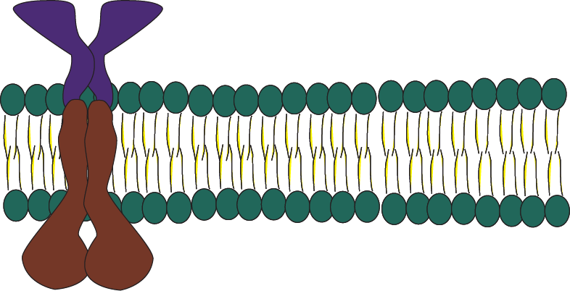
Insulin Signaling – PI3K Signaling
Insulin
P
P
IRS
PI(4,5)P₂
PI(3,4,5)P₃
p85
P
P
P
p110
P
P
P
Class I PI3K

Slide 30
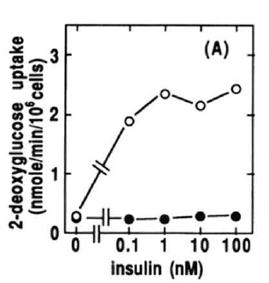
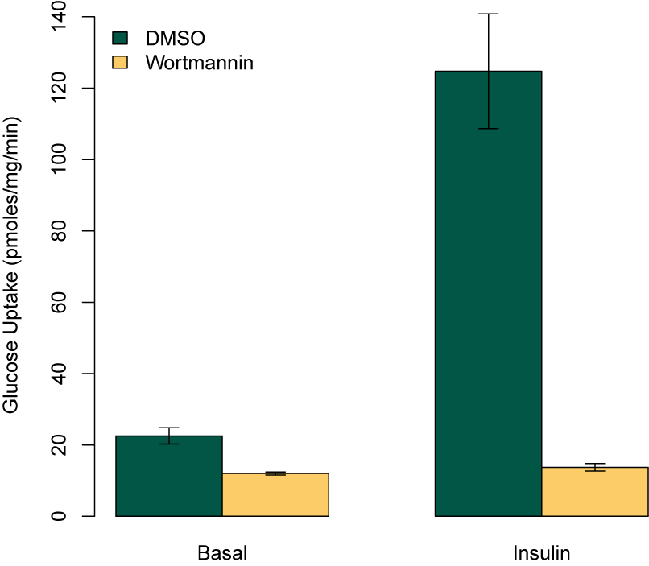
Key Role of PI3K in Insulin Signaling
Kanai et al (1993) Biochem Biophys. Res. Comm. 195:762:768

Slide 31
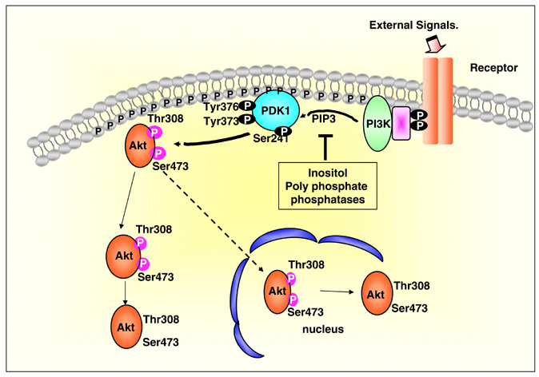
Akt Activation by the PI3K Pathway
mTORC2
Notes:
Virtually all relevant insulin signaling requires the activation of Akt
Make sure to mention that all of these phosphorylation events can be reversed by protein phosphatases

Slide 32
Problem Solving Break
Can you think of two drug targets
One that restricts insulin signaling
One that will promote insulin signaling

Slide 33
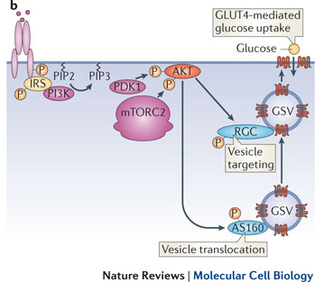
Insulin Stimulated GLUT4 Translocation
Leto and Saltiel Nat. Rev. MCB (2012)

Slide 34
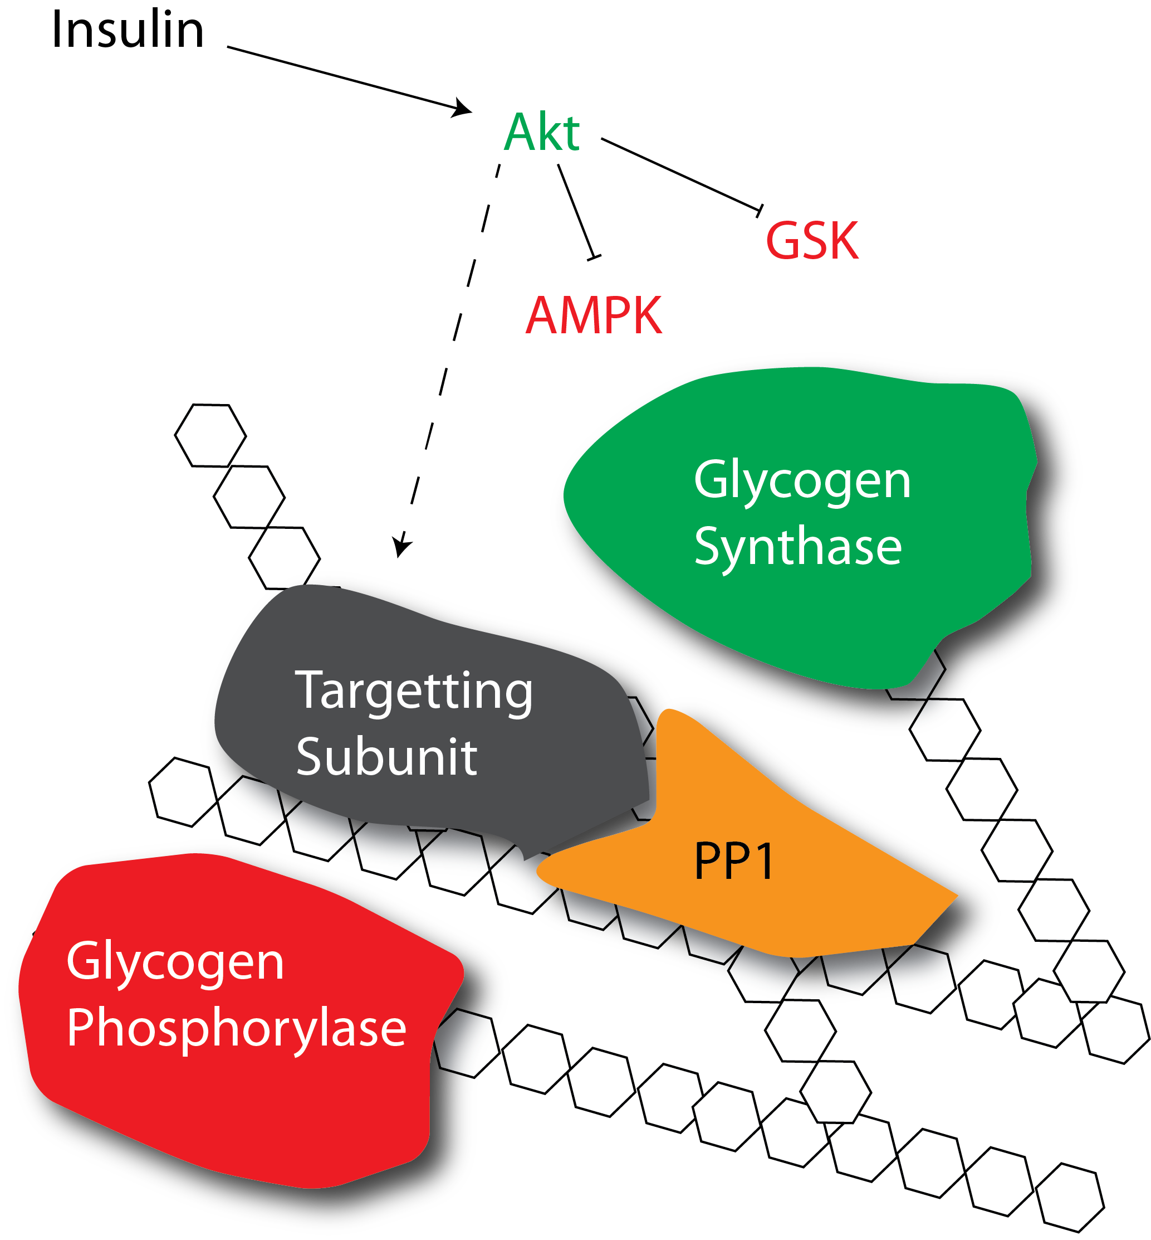
How does insulin promote glycogenesis?
Allosteric activation
Protein dephosphorylation
Notes:
First ask about which mediators are increased with insulin, or see what the allosteric activation of GS looks like

Slide 35
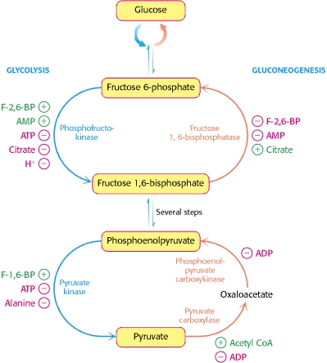
How does insulin reduce gluconeogenesis
FBPase is negatively regulated by F-2,6-BP
PEPCK and G6Pase are inhibited by insulin
Allosterically
Protein phosphorylation
Transcriptionally repressed
Notes:
First, does insulin promote or reduce gluconeogenesis

Slide 36
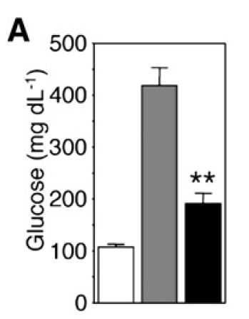
Transcriptional Regulation of Gluconeogenesis
Akt
PEPCK
G6Pase
P
Knockout
IR
IR +
FOXO
FOXO
P
P
Matsumoto et al. (2007) Cell Metab. 6:208-16

Slide 37
Problem Solving Break
Can you think a drug target and why that it may be useful
To enhance glycogen levels
That prevents gluconeogenesis
Notes:
Give about 3 minutes to discuss

Slide 38
Mechanisms to Increase Blood Glucose

Slide 39
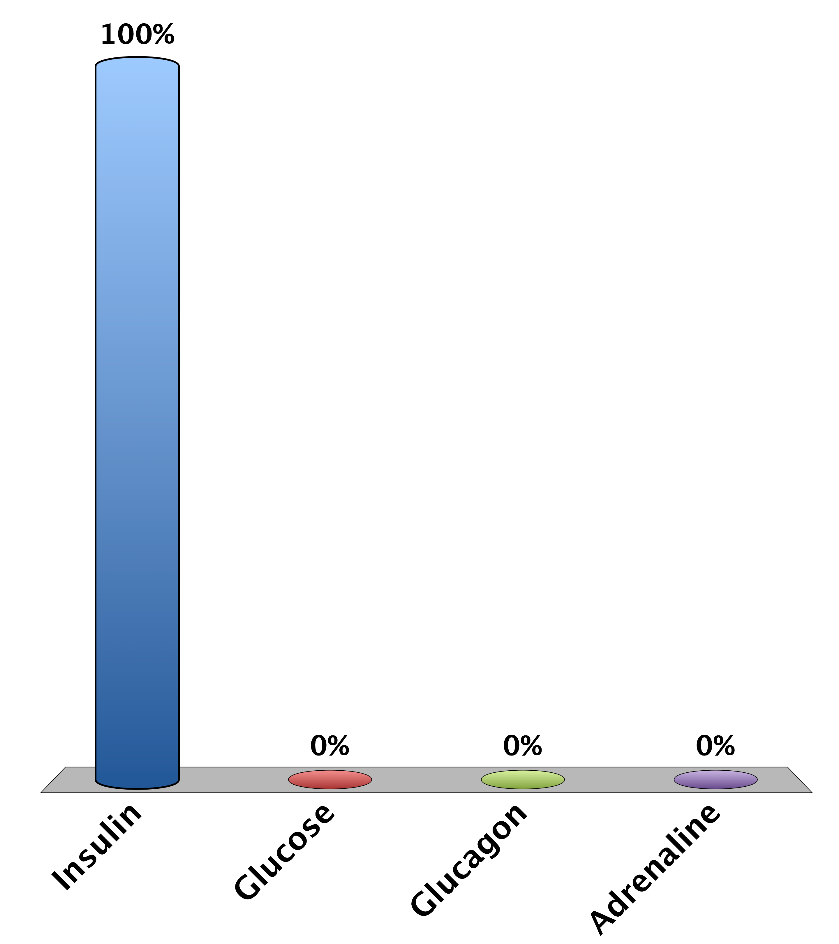
A patient is rushed to the hospital with low blood glucose, what would be a bad treatment?
Insulin
Glucose
Glucagon
Adrenaline
0

Slide 40
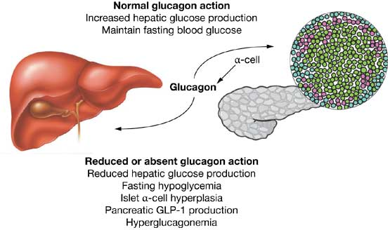
Glucagon Secretion
Secreted from alpha cells of the pancreas
Released by low blood sugar levels
Acts on the liver not the muscle or fat tissues
Drucker (2013): Nat Rev Endo 1:22-31

Slide 41
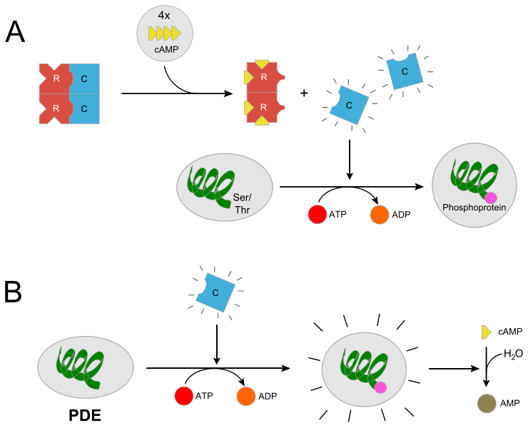
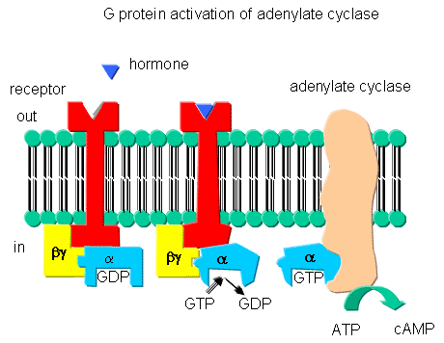
Glucagon Signaling
From http://biowiki.ucdavis.edu/Biochemistry/Signal_Transduction/Signal_Transduction_at_Cell_Membranes%3A_Protein_Kinases_and_Phosphotases
From http://en.wikipedia.org/wiki/Protein_kinase_A
Notes:
Potentially spend some time on earl sutherland’s experiments

Slide 42
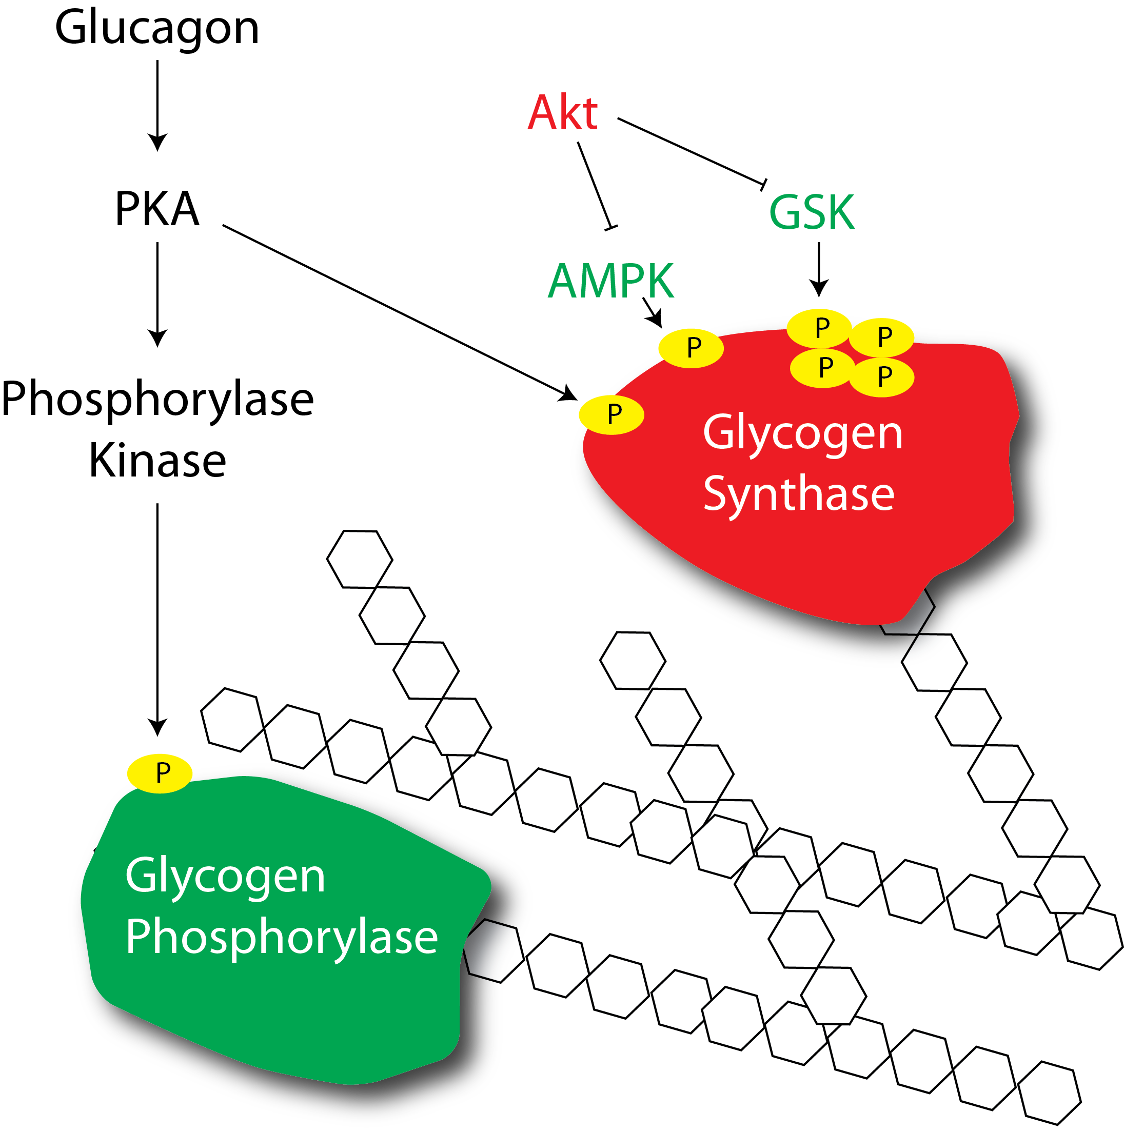
How does glucagon regulate glycogenolysis?

Slide 43
How does glucagon promote gluconeogenesis?
PKA
PFK-2
Notes:
Ask, if we modulate F26P to promote gluconeogenesis, what would we want to do to it

Slide 44
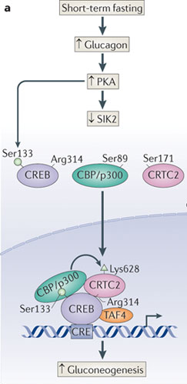
Transcriptional Regulation of Gluconeogenesis
More G6Pase, FBPase and PEPCK
Altajeros and Montminy (2008) Nat. Rev. MCB. 3:141-151

Slide 45
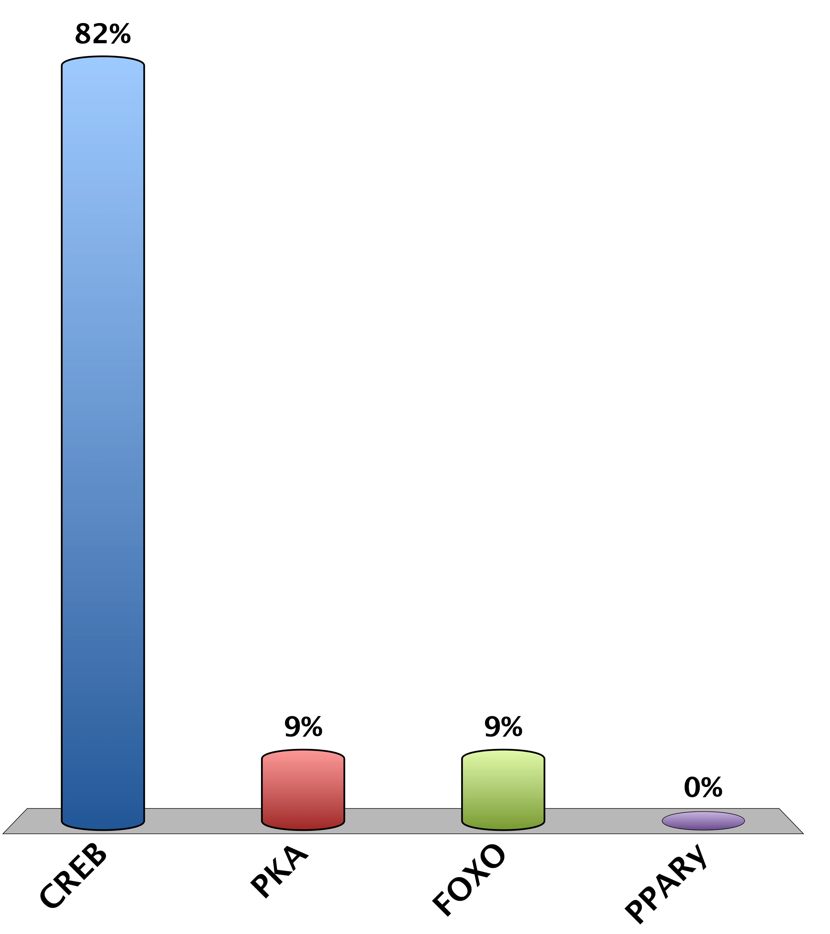
Inhibiting which transcription factor would decrease gluconeogenesis
CREB
PKA
FOXO
PPARy
0

Slide 46
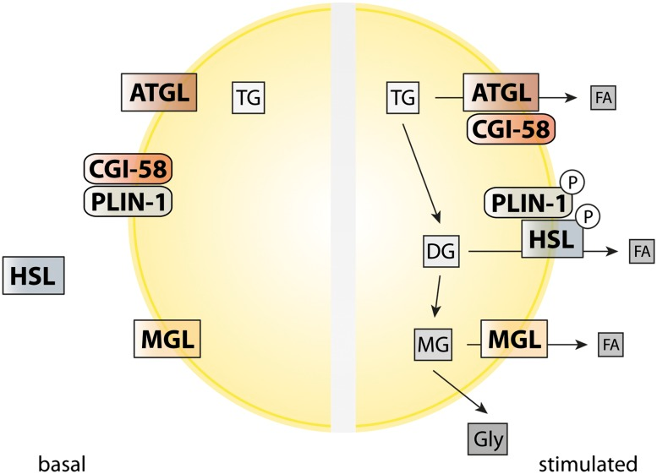
Adrenaline and the Sympathetic Nervous System
Glucagon primarily affects the liver
Adrenaline activates GPCR signaling in fat and muscle tissue
In fat tissue, the primary function is lipolysis
In muscle the primary function is glycolysis and oxidative respiration
These do not dramatically affect acute glucose homeostasis
Young and Zechner (2013) Genes Dev. 27: 459-84

Slide 47
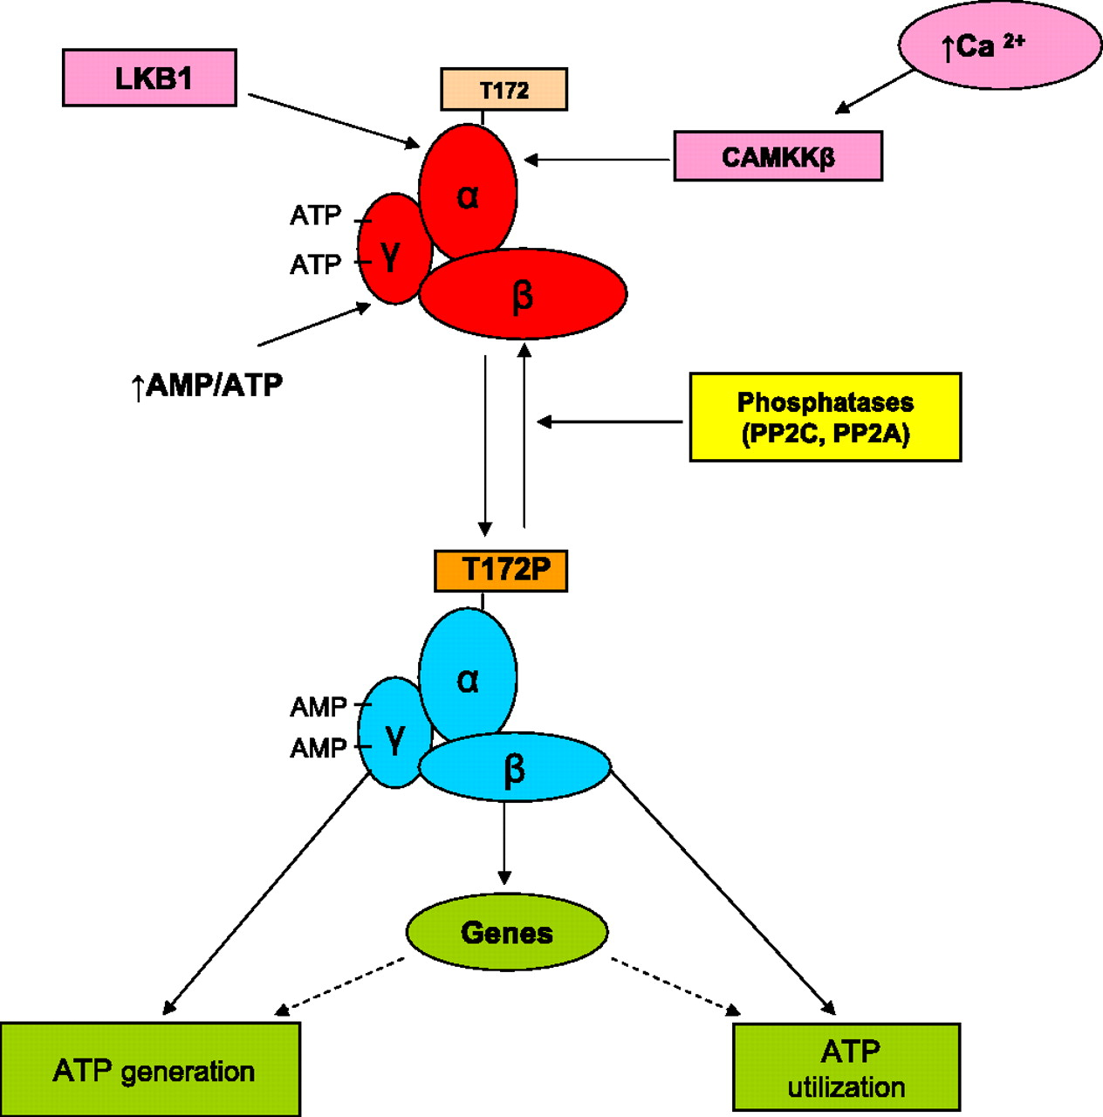
Responses to Energy Stress
Ruderman et al. (2010) Am. J. Physio. 298:E751-760
Notes:
Point out that AMPK works to generate energy wheras insulin works to reduce glucose. Based on that what things would be the same between these pathways and what things would be different?

Slide 48
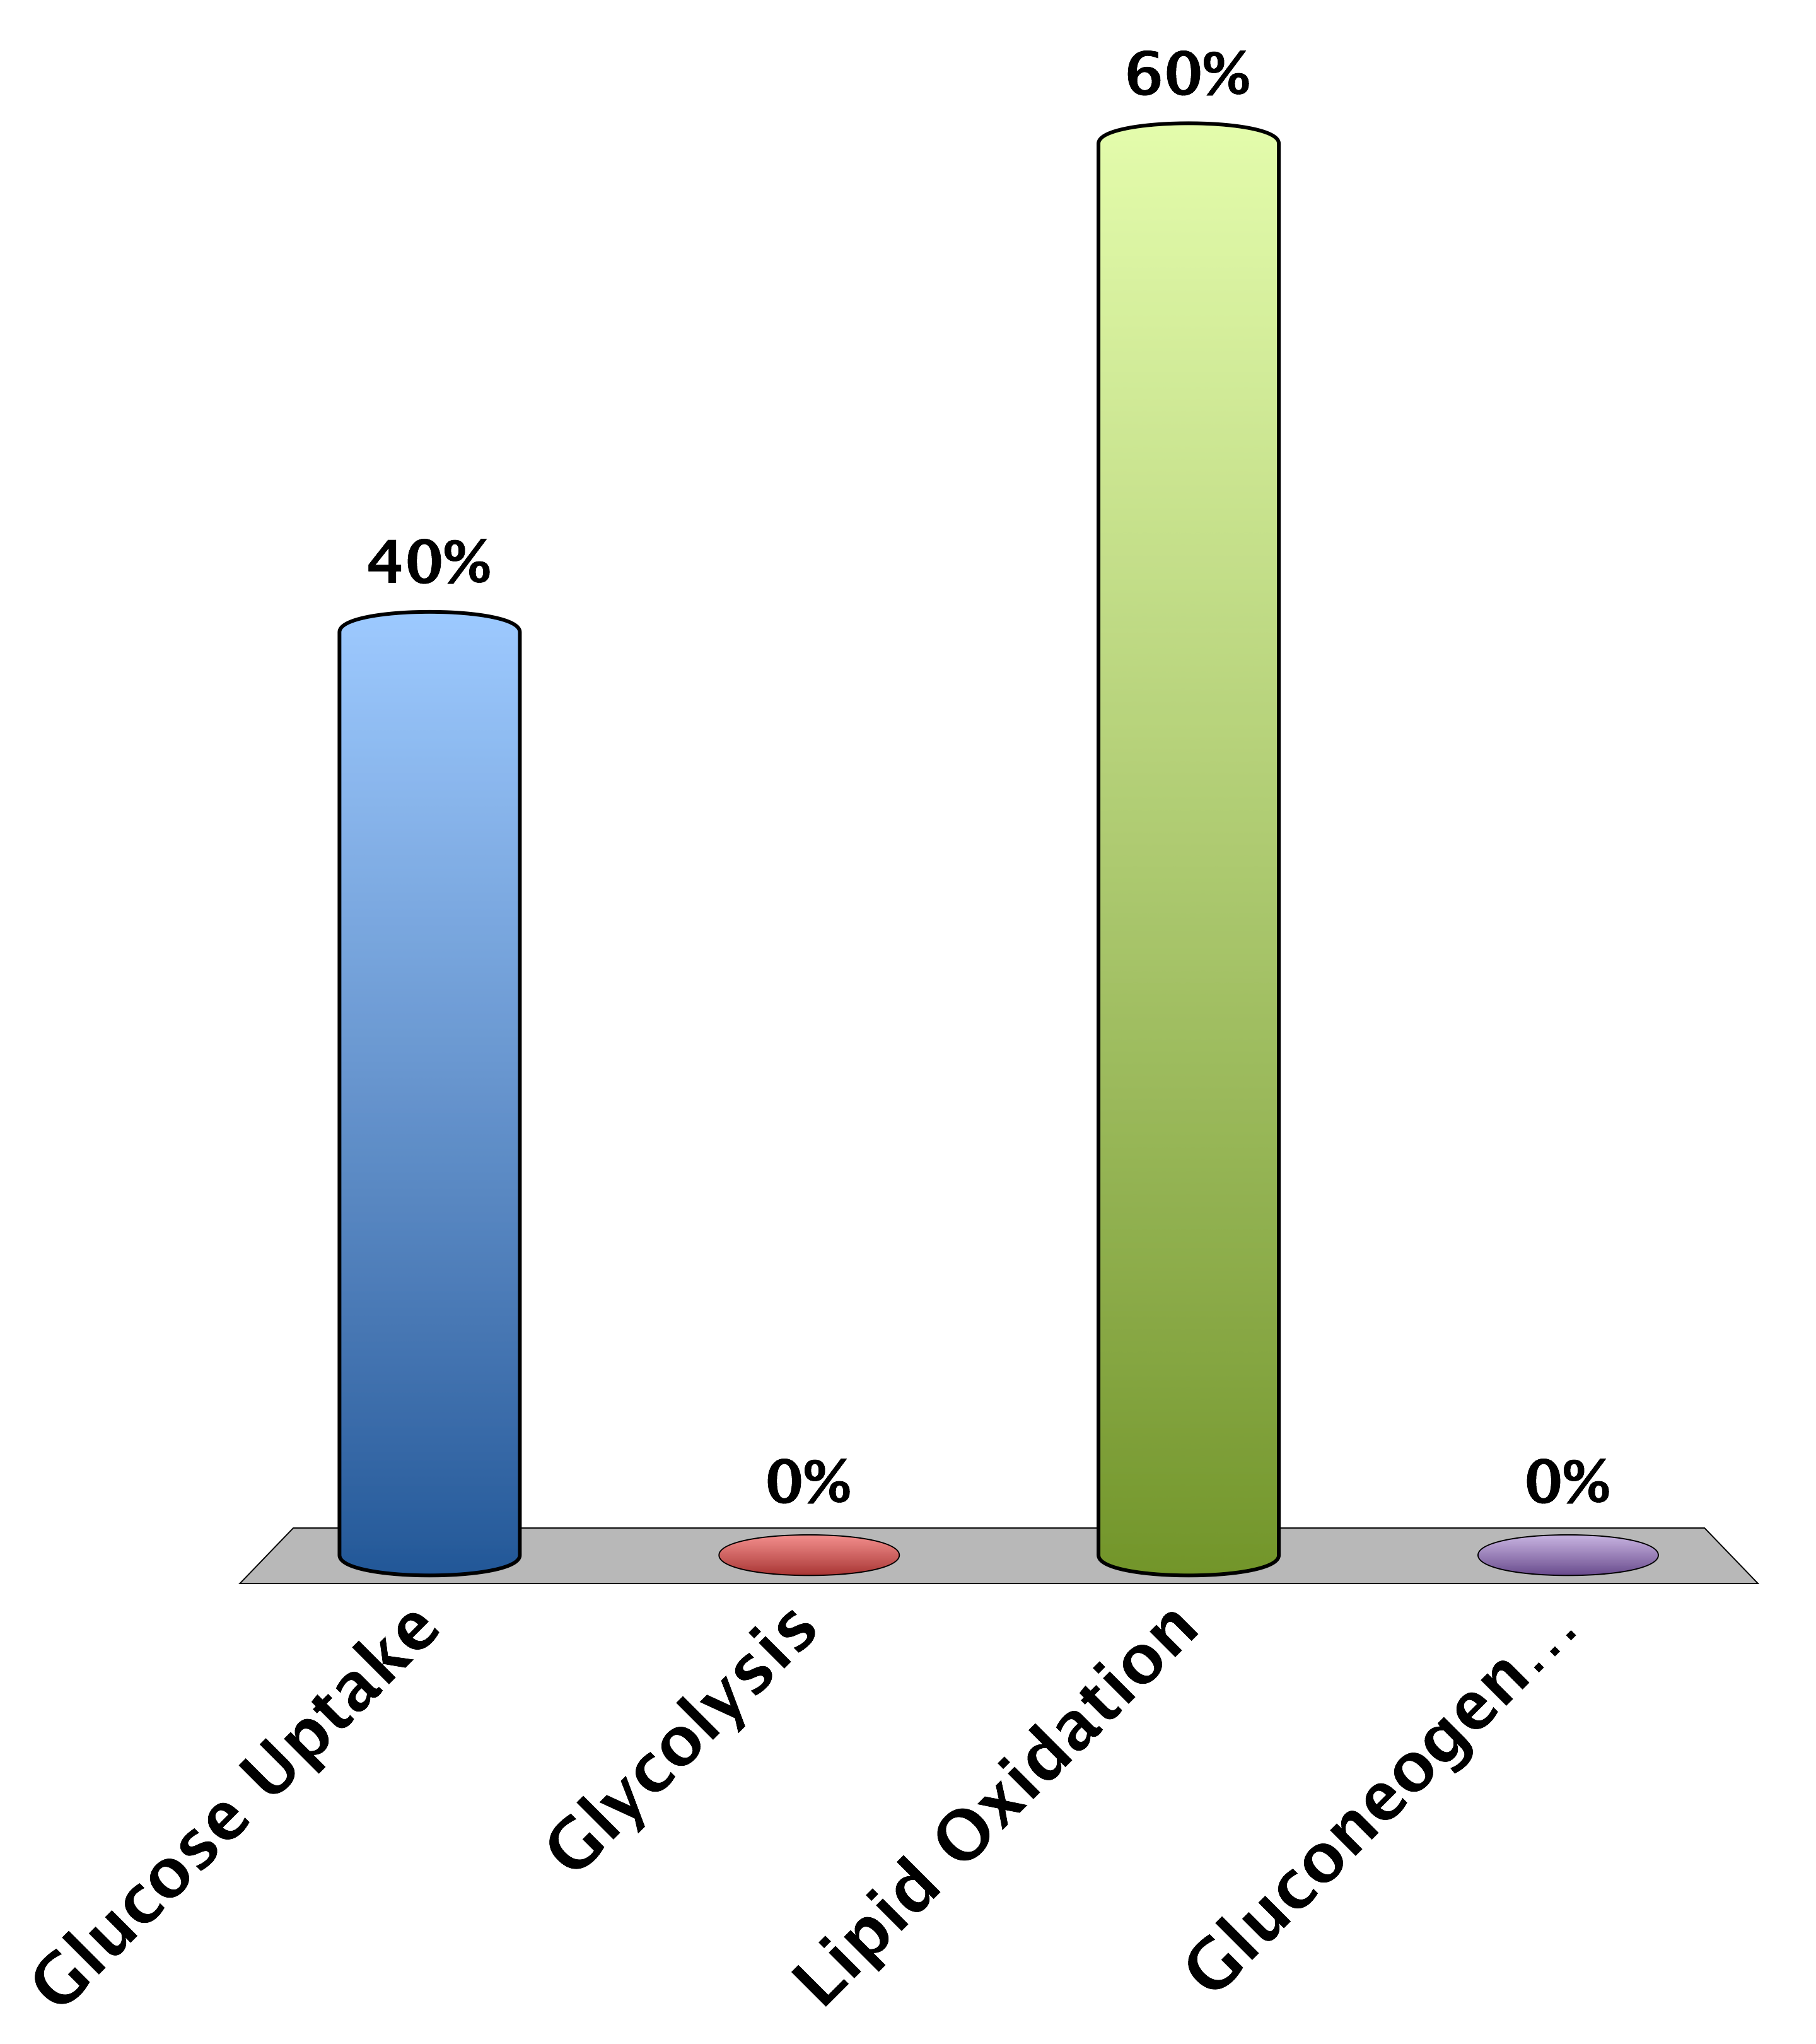
What process would AMPK and Akt Regulate Differently
Glucose Uptake
Glycolysis
Lipid Oxidation
Gluconeogenesis
0

Slide 49
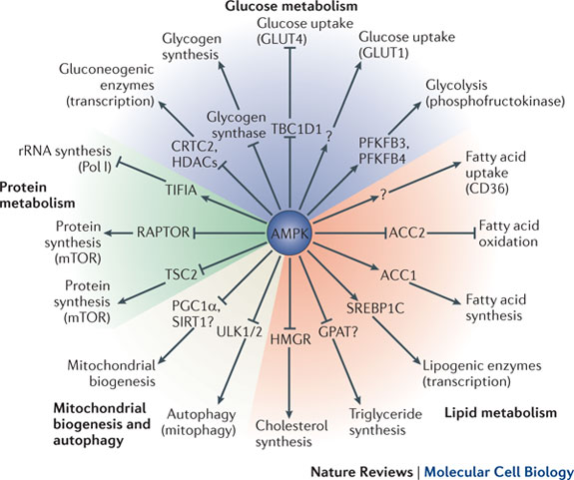
Roles of AMPK
Hardie et al. (2012) Nat. Rev. MCB 13: 251-62
Notes:
Point out that AMPK works to generate energy wheras insulin works to reduce glucose. Based on that what things would be the same between these pathways and what things would be different?

Slide 50
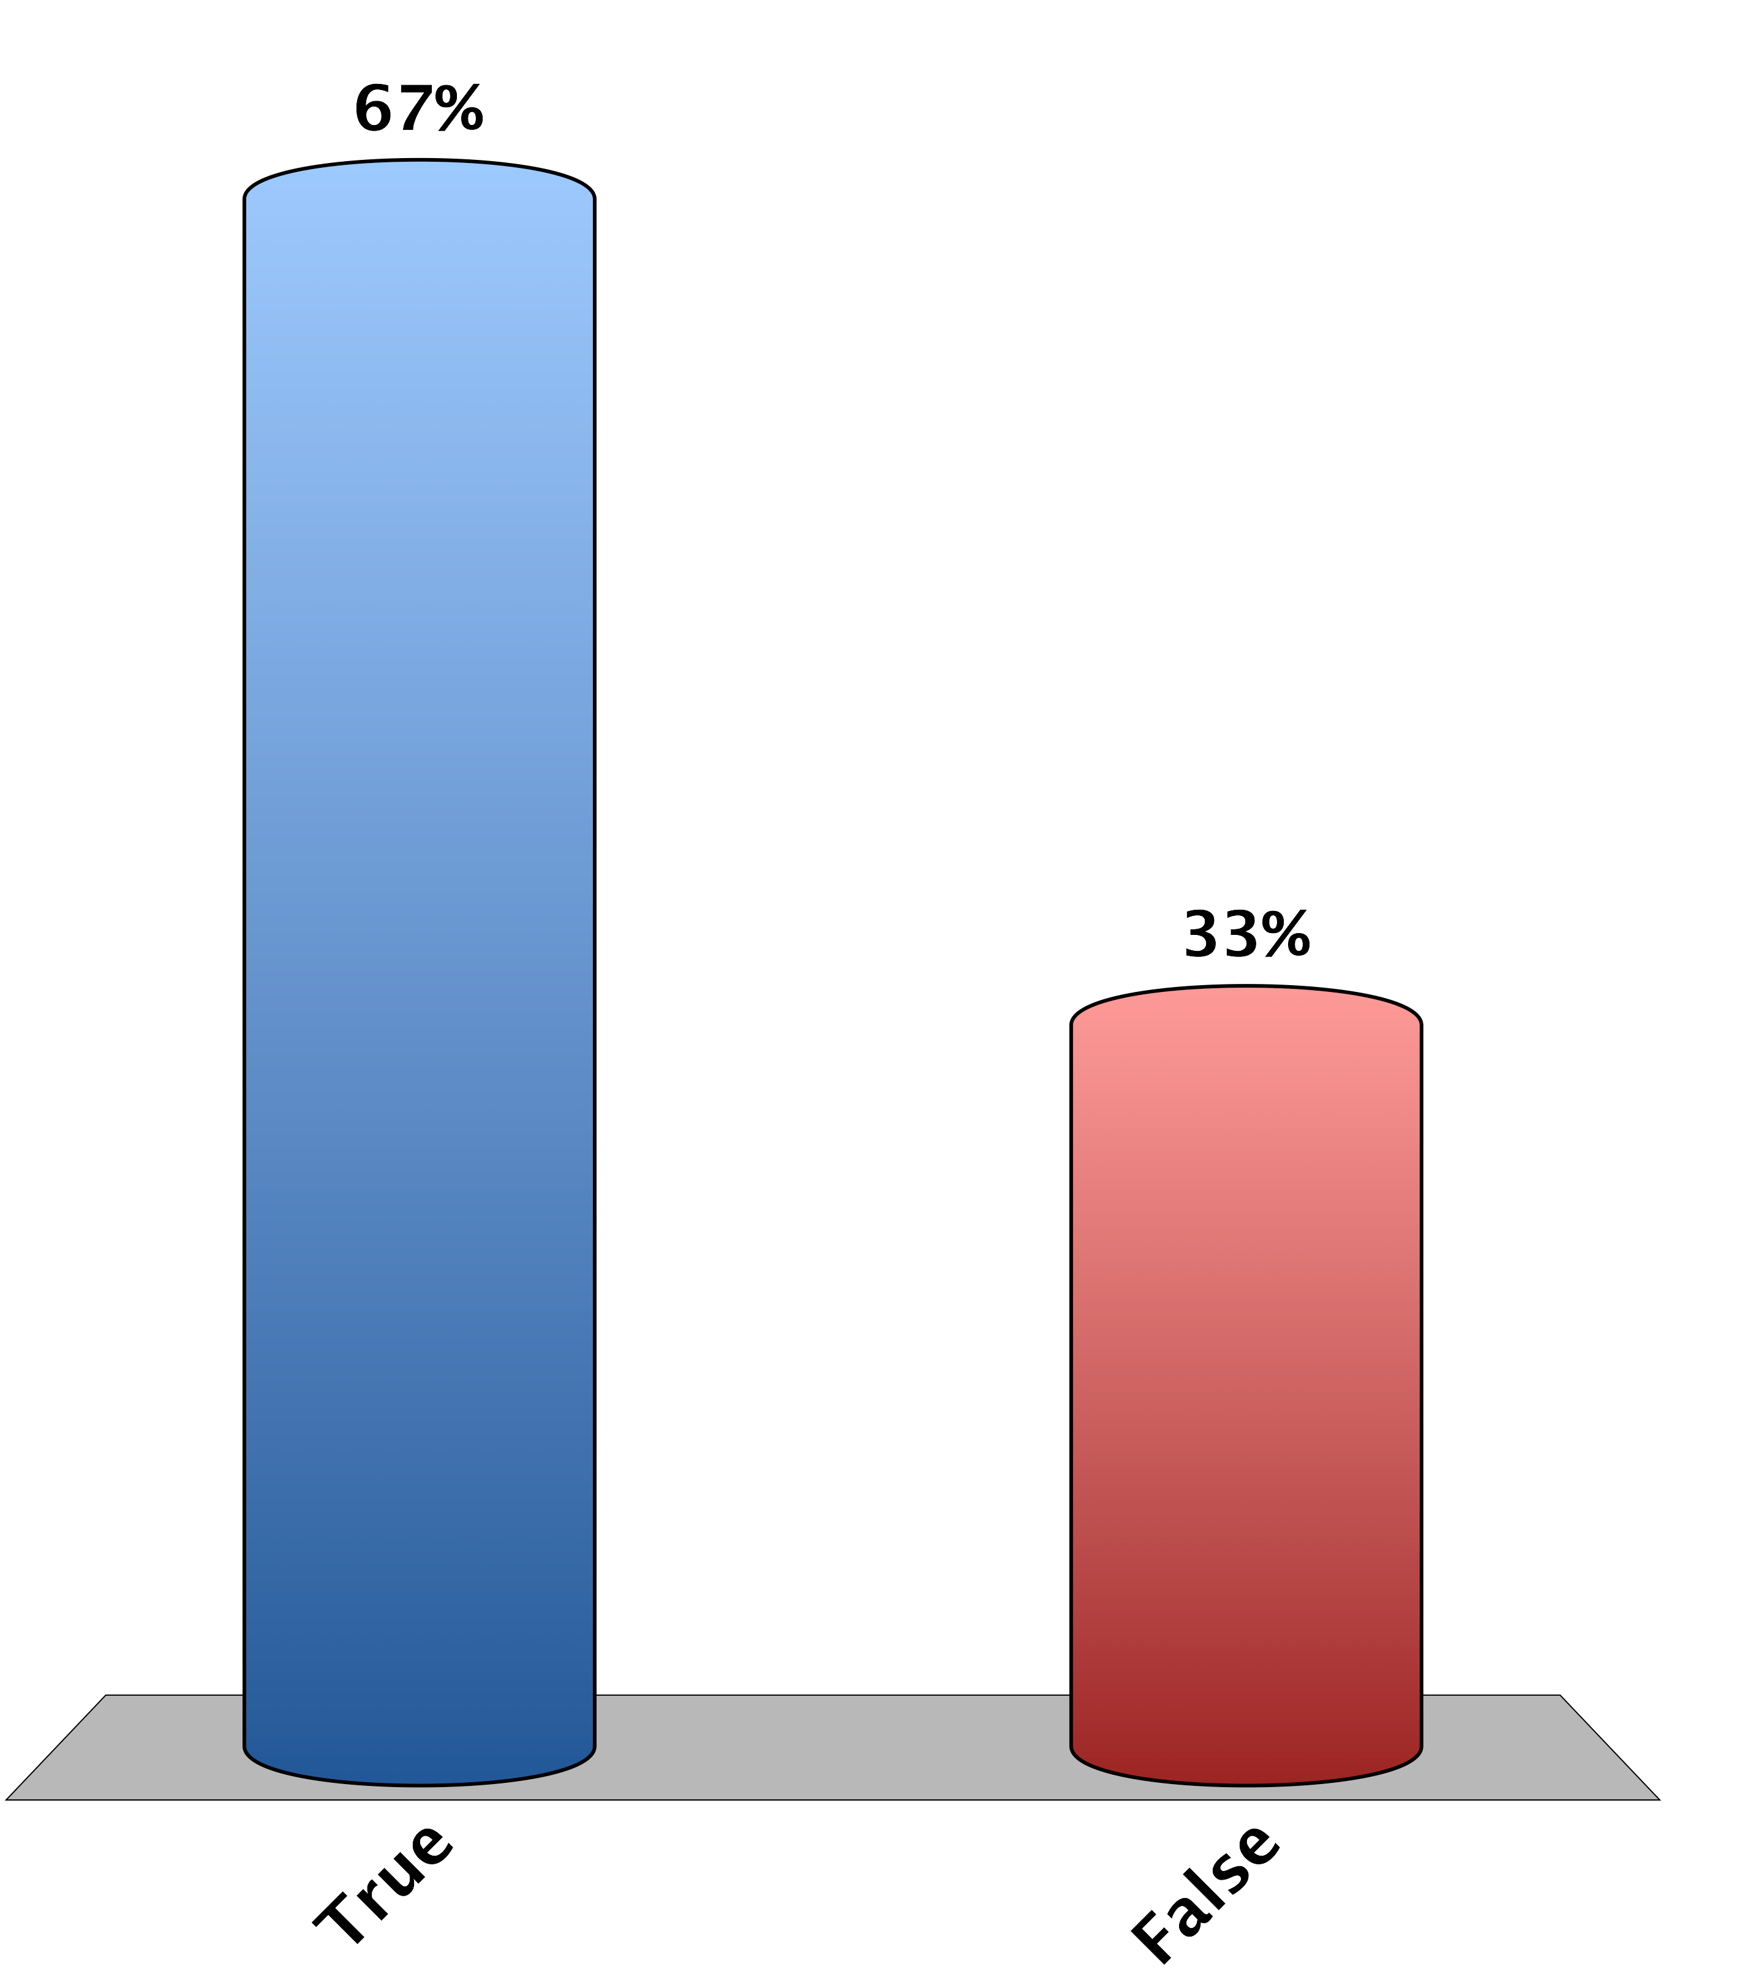
When Glycogen Synthase and Glycogen Dephosphorylase are NOT Phosphorylated there is more glycogen synthesis
True
False
0

Slide 51
Problem Solving Break
Can you think a drug target that would
Cause the accumulation of muscle glycogen
Induce the mobilization and oxidation of lipids

Slide 52
Pathophysiology of Glucose Control

Slide 53
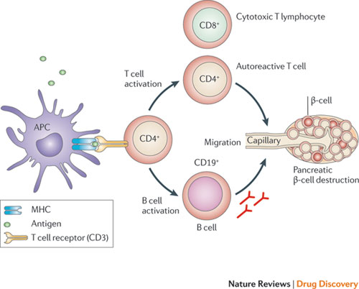
Type I Diabetes Results from a Loss of Beta Cells

Slide 54
Type II Diabetes
Excessive nutrient storage
Tissues Become Insulin Resistant
Pancreas Compensates by Secreting More Insulin to Normalize Glucose
Tissues Become More Insulin Resistant
Eventually Pancreas Fails to Compensate
Hyperglycemia

Slide 55
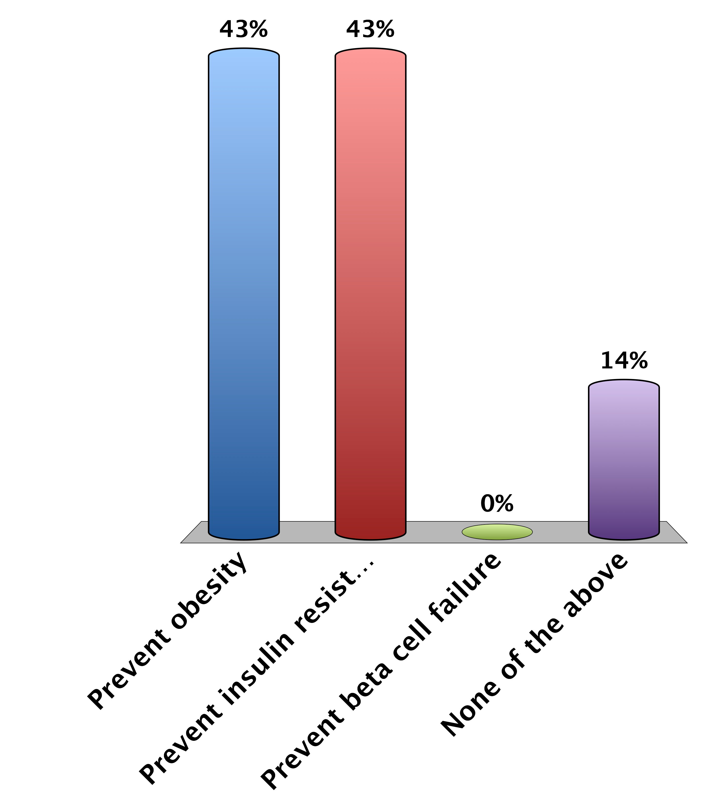
What May Prevent Type II Diabetes?
Prevent obesity
Prevent insulin resistance
Prevent beta cell failure
None of the above
0

Slide 56
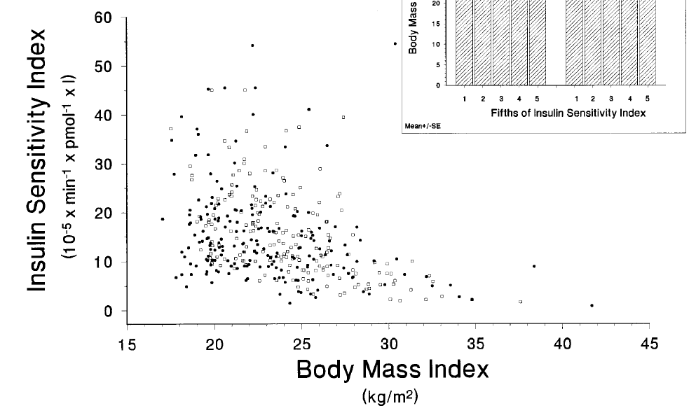
Why Is There Insulin Resistance
Negative feedback loops are common in most endocrine organs
A mechanism to avoid excessive nutrient storage
The “Thrifty Genotype” Hypothesis
Clausen et al. 1996 J. Clin. Invest. 98:1195–1209
Notes:
Spend some time discussing what would happen Insulin resistance and pancreatic responses underlie progression from weight gain to diabetes
if someone is obese but resistant to diabetes

Slide 57

How Could Insulin Resistance Lead to Hyperglycemia?
More glucose uptake
Less lipid storage
More gluconeogenesis
None of the above
10

Slide 58


Liver Insulin Receptor Knockout
Michael et al. (2000) Mol Cell 6:87-97

Slide 59



Molecular Mechanisms of Insulin Resistance
Saad et al. (1992)
J. Clin. Invest. 90:1839–1849
Goodyear et al. (1995) J Clin Invest 95: 2195-204
Notes:
If PI3K activity is decreased, what upstream problems could cause that?

Slide 60

IRS Serine Phosphorylation
Boura-Halfon and Zick (2009) Am. J. Endo. Metab. 296:E581-E591

Slide 61
Mechanisms of Insulin Resistance
Overnutrition induced insulin resistance
Lipid mediated insulin resistance
Inflammation associated insulin resistance

Slide 62

Nutrient Overload -> Insulin Resistance
Patti and Kahn (2009) Nat Med 10:1049-50

Slide 63

Obesity is an Inflammatory State
Image from http://sitemaker.umich.edu/lumeng.lab/research

Slide 64

Inflammation -> Insulin Resistance
Kim (2012) Circulation 125: 1081-83

Slide 65

Lipid Accumulation -> Insulin Resistance
Erion and Shulman (2010) Nature Medicine 16:400-402

Slide 66
Several Potential Novel Drug Targets
New drug targets
mTORC1
JNK/IKK
Protein Kinase C
What would be the downside of increasing insulin sensitivity in an obese patient?

Slide 67

The main downside to insulin sensitization is…
Lower gluconeogenesis
Less blood glucose
More fat storage
Less glycogen storage
10

Slide 68
Treatments for Diabetes

Slide 69


Treatments for Type I Diabetes
Insulin Injections
Islet Transplantations
Long vs Short Acting Insulin
Insulin Pumps

Slide 70
Treatments for Type II Diabetes
Normalize blood glucose levels
Store it in body tissues
Excrete it
Burn the ex

Slide 71

Store Excess Glucose I – Provide or Secrete More Insulin
Sulfonylureas
Tolbutamide
Glyburide
Another class that improves insulin secretion is GLP1 agonists or DPP inhibitors (lecture in 2 weeks by Dr. Cook)
Suckale and Solimena (2008) Frontiers in bioscience 13:7156-71
Notes:
First talk about providing more insulin. What would be the downside of providing more insulin?

Slide 72

Store Excess Glucose II – Insulin Sensitizers
Thiazolidinediones
Agonists of PPARy transcription factor
Promotes lipid storage and oxidation as well as new fat cells
Rosiglitazone (Avandia) and Pioglitazone (Actos)
Cardiovascular events

Slide 73

Glucose Secretion
Ferrannini and Solini (2012) Nat Rev Endo 8:495-502

Slide 74

Glucose Utilization
Biguanides Metformin and Phenformin
They cause increases in AMP levels and activation of AMPK signaling
Mimics the effects of exercise

Slide 75
Thank you for your attention
Please drop off your survey

